Slide 1
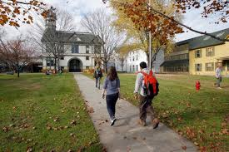
CLIC: Community Legal Information Corner
Natalia May
CLIC Coordinator
Vermont Law School
Spring 2016
Notes:
Thank you, Cynthia! And thank you for this great opportunity to tell you about Community Legal Information Corner (CLIC for short), a new resource of legal reference in Vermont.

Slide 2
Notes:
As most of you have probably heard, the Vermont State Law Library closed last summer. So, Cornell Library at Vermont Law School stepped up to provide legal reference services to the community. The annual grant through the VT Department of Libraries to Vermont Law School enabled the creation of the Community Legal Information Corner on VLS campus.

Slide 3
Notes:
Vermont Law School is a private, American Bar Association-accredited, law school located in South Royalton (exit 2 off I-89). It was founded 44 years ago, and has been consistently the #1 national school in Environmental Law. It is also ranked nationally for its experiential programs, which allow students to get real life legal experience. Enrollment is over 600 students who graduate with Juris Doctor degrees and/or various Masters Degrees. Since the motto of the school is Law for the Community and the World, it was logical to open CLIC on VLS campus.

Slide 4
Notes:
Under the grant, Cornell Library had to hire CLIC Coordinator. So, I applied for the vacancy, which sounded like a “dream job” to me, as it had 3 of my “favorite things”: law + library science + VLS.

Slide 5
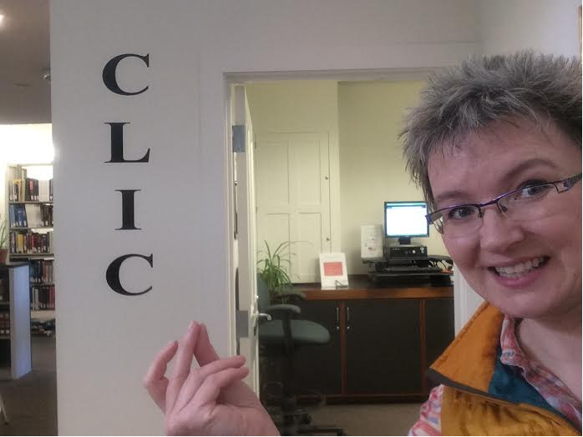
Notes:
I learned about VLS 25 years ago, when I was a TV journalist in Russia and interviewed visiting VLS faculty. A couple of years later I immigrated to the US (Vermont) and I re-tooled myself by earning JD degree from VLS, and Masters in Library Science from Simmons College. I also did diverse community service work: volunteering at my local Hartland Public Library, VA Medical Center in WRJ; also became a Vermont Community Rep of Digital Public Library of America.

Slide 6
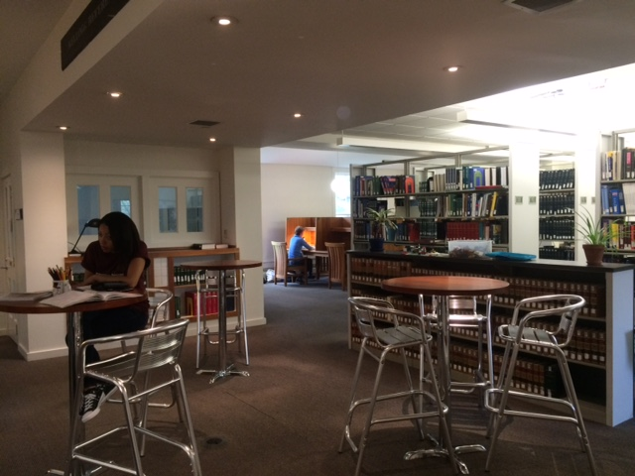
Notes:
As CLIC Coordinator, I 1) provide access to legal information, 2) enrich collection based on statistics of usage, 3) create LibGuides to assist patrons and reference librarians, and, of course 4) train librarians on how to provide legal reference to the public- exactly what we are doing here today!

Slide 7
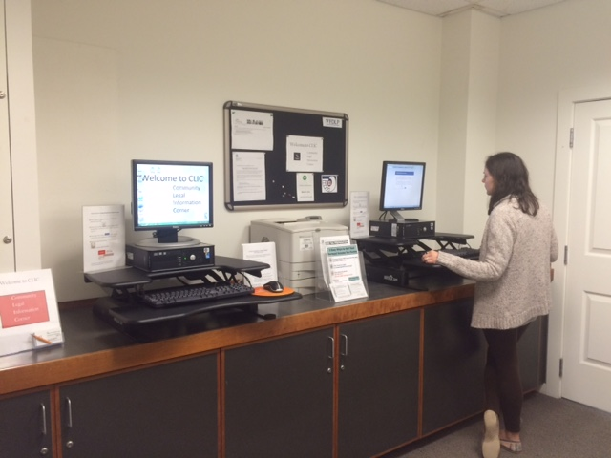
Notes:
CLIC is situated on the first floor of Cornell Library and has two walk-in Westlaw terminals.

Slide 8
Notes:
As you may know, Westlaw is one of the primary online legal research services for lawyers and law students in the United States.
Subscription Westlaw includes more than 40,000 databases of case law, state and federal statutes, administrative codes, newspaper and magazine articles, public records, law journals, law reviews, treatises, legal forms and other information resources.
CLIC WL is free for public; although not as all-inclusive as a subscription one, it satisfies the majority of public inquiries. We are also planning to broaden our CLIC WL offerings this summer. It is pretty intuitive database, so anyone can come to CLIC and search it.

Slide 9
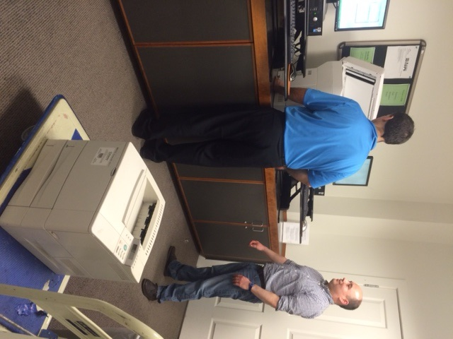
Notes:
The WL search results can be emailed, uploaded to a patron’s USB drive, or printed out- all free of charge for patrons. Here you can see the installation of the CLIC’s brand new printer, which happened last week.

Slide 10
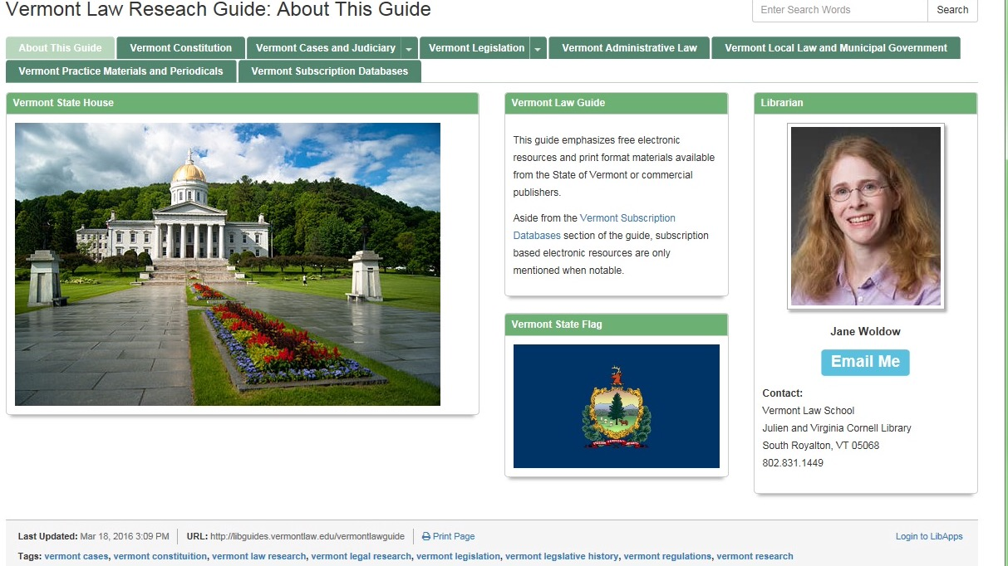
Notes:
Among other CLIC legal research tools are also open access LibGuides. Here Jane Woldow, one of our six Reference Librarians, invites you and your patrons to use her VT Law Research Guide, where you can find: text of VT Constitution and VT Cases, as well as information on VT Judiciary, VT Legislation, VT Administrative Law, VT Local & Municipal Government, and VT Practice Materials & Periodicals.

Slide 11
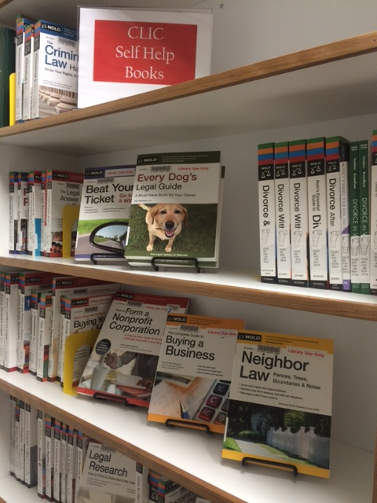
Notes:
CLIC growing print collection contains numerous NOLO books. As you may know, NOLO is a publisher of self-help texts: a wide range from dealing with a dog’s bite to fighting a DUI ticket , from filing for a divorce to building a small claim case (SHOW THE NOLOs).

Slide 12
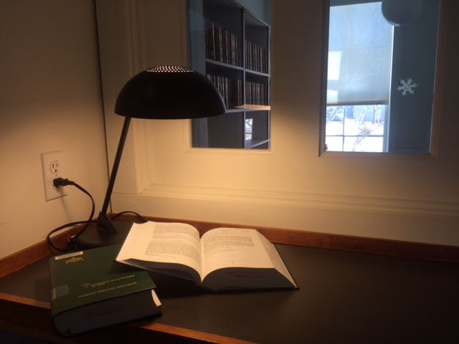
Notes:
CLIC Vermont legal collection contains statutes, forms, and jurisdiction-specific reference materials. This collection has been well used by self-represented litigants, as well as local attorneys (SHOW VT FORMS BOOK).

Slide 13
Notes:
To analyze CLIC usage, we utilize Gimlet, an economical yet effective statistics software favored by many librarians.
I imagine some of you use Gimlet.
I populate Gimlet to track patrons’ questions, search answers, predict trends, and build reports.

Slide 14
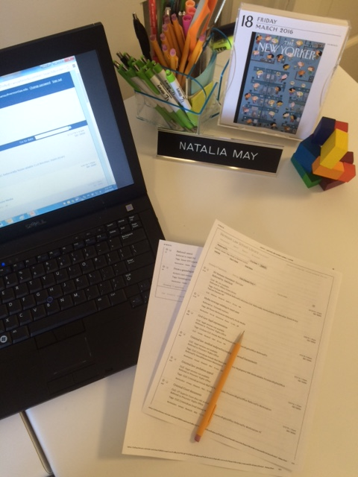
Notes:
With Gimlet I can gather statistics by 1) question type (directional or research), 2) question format (email/phone/walk-in/mail), also 3) whether CLIC was referred to a patron by someone, or 4) whether CLIC patron is referred to someone for the further help.

Slide 15
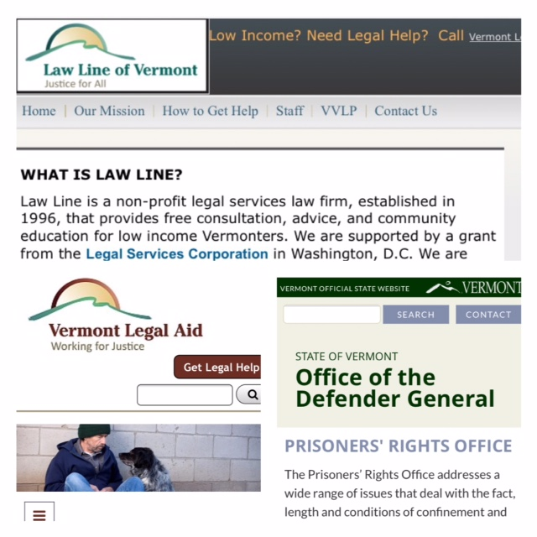
Notes:
“We are the law library and not the law office,” so we refer our public patrons (around 10% of them) to legal entities to get legal help: VT Legal Aid, Law Line, and Prisoners’ Rights Office at the VT Defender General. The Prisoners Right’s Office handles inquiries from inmates.

Slide 16
Notes:
In certain cases, South Royalton Legal Clinic is another legal entity that is available for some Vermont residents. Situated on VLS campus, it is the first and still the only law student-staffed office providing legal representation in the state. Under the supervision of experienced staff attorneys, the Legal Clinic handles Civil Law matters, free for qualified low-income Vermonters primarily from Windsor and Orange Counties, and immigrants state-wide.

Slide 17
Notes:
The present break down of CLIC patrons is based on the 4 months statistics: about 250 inquiries in 4 mos/about 2 inquiries daily (each inquiry may take anywhere from 5 minutes to over an hour to answer). So, it has been steady for our 6 Reference Librarians: daily, Monday through Saturday, someone is on Reference Duty.
General public (including self-represented or pro se litigants)- BLUE (26%)
Inmates- RED (46%)
Attorneys (incl. paralegals)- GREEN (28%)
While general public and attorneys email us (26%), come to us (25%), or call us (15%), inmates write to us.

Slide 18
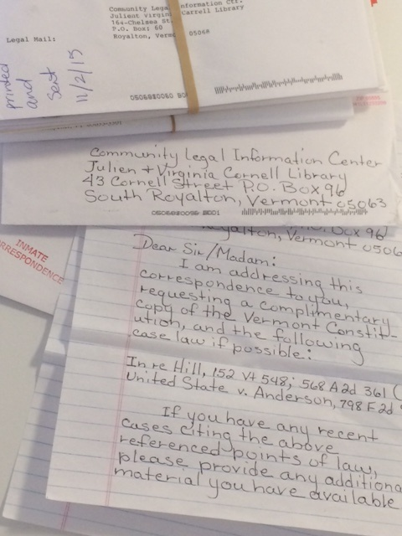
Notes:
Inmates’ letters reach us several times a week. Most of them are looking for cases they can use to advocate their own post-conviction relief.

Slide 19
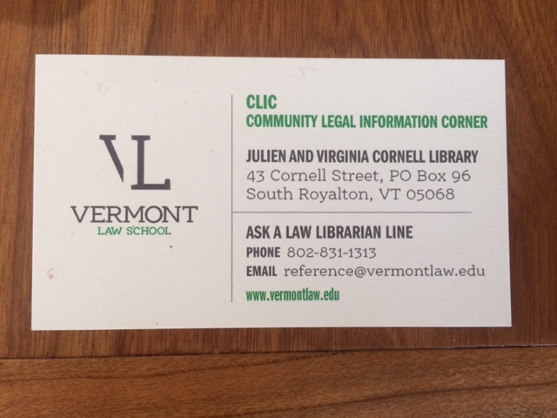
Notes:
Apart from walking into CLIC or writing a letter, patrons can call the Ask a Law Librarian Line 831-1313 or email to reference@vermontlaw.edu (I HAVE THESE BUSINESS CARDS FOR YOU AFTER THE PRESENTTION). The inquiries are typically answered during business hours within a day or so.

Slide 20
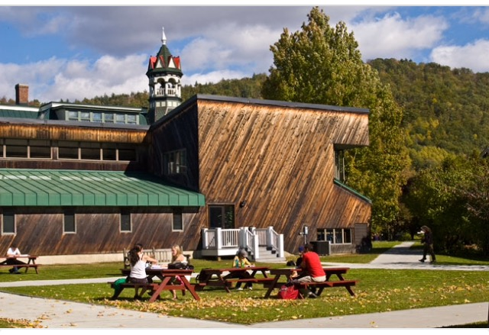
Notes:
Hopefully, today’s presentation has shed some light onto legal reference resources that are available to you and your patrons. Come and visit us at Vermont Law School, take CLIC business cards and spread the word.

Slide 21
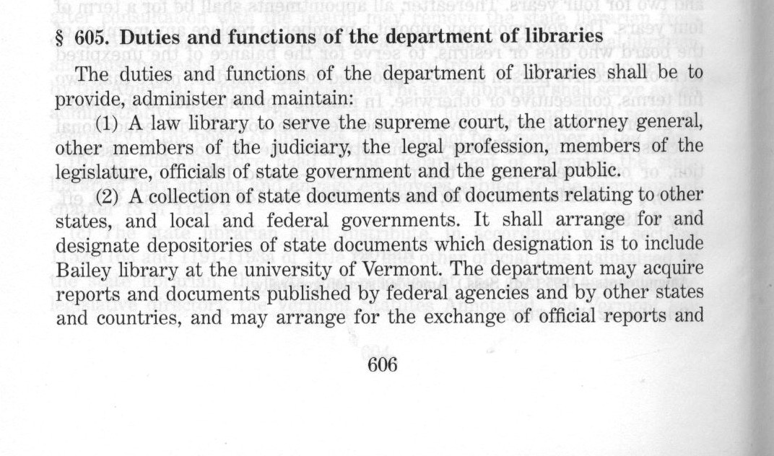
Notes:
Since we’ve been talking about legal resources, here is the language from Section 605 of Title 22 of Vermont Statutes Annotated, which mandates the State of Vermont to have a state law library to serve, among other people, “members of the legal profession, legislature, officials of state government and the general public.”

Slide 22
Notes:
Thus, CLIC has been effectively fulfilling the role of the state law library. We are grateful for the grant through the VT Department of Libraries. We are hoping that after the initial baby steps CLIC will continue to grow and serve the Vermont community.

Slide 23
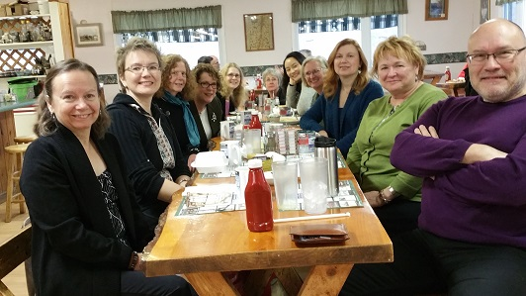
Notes:
In conclusion, “it takes a village to raise CLIC!” So, CLIC is a truly team effort and would not have been possible without help of my wonderful colleagues at Cornell Library (from Right to Left): Carl, Michele, Lisa, Rhonda, Chenfang, Beth, Jane, Cynthia, Christine, and Jane.

Slide 24
Thank you!
Natalia May
CLIC Coordinator
namay@vermontlaw.edu
(802) 831-1440
Notes:
I appreciate your time and attention and will be happy to answer any questions.
Don’t forget CLIC business cards!

