Slide 1
Legal Reference for Public Librarians
Vermont Library Conference
May 18, 2016
Cynthia Lewis & Natalia May

Slide 2
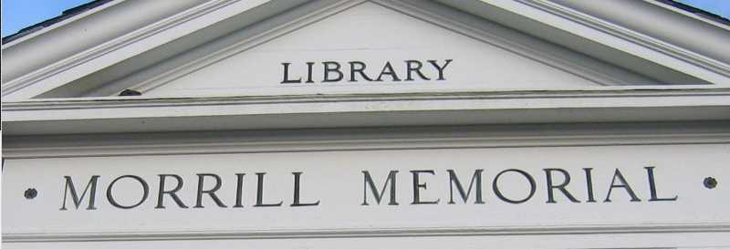
Legal resources in your library

Slide 3
Resources for VT Legal Research
Vermont Statutes Annotated – 31+ volumes
Vermont Court Rules Annotated
Vermont Rules of Evidence
Vermont Reports
Vermont Key Number Digest
Code of Vermont Rules
Vermont Family Law
State Documents Bibliography: Vermont

Slide 4
Vermont Statutes Annotated
Declaration of Independence
Articles of Confederation
U.S. and Vermont Constitutions
Title 24 Appendices – Charters
Title 10 – Act 250 Land Use & Development
Title 12 Court Procedure
Rules of Procedure

Slide 5
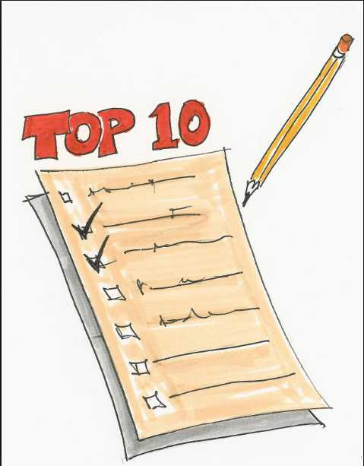
Free Online Legal Research
Top 10 Legal Research Web Sites for Vermonters

Slide 6
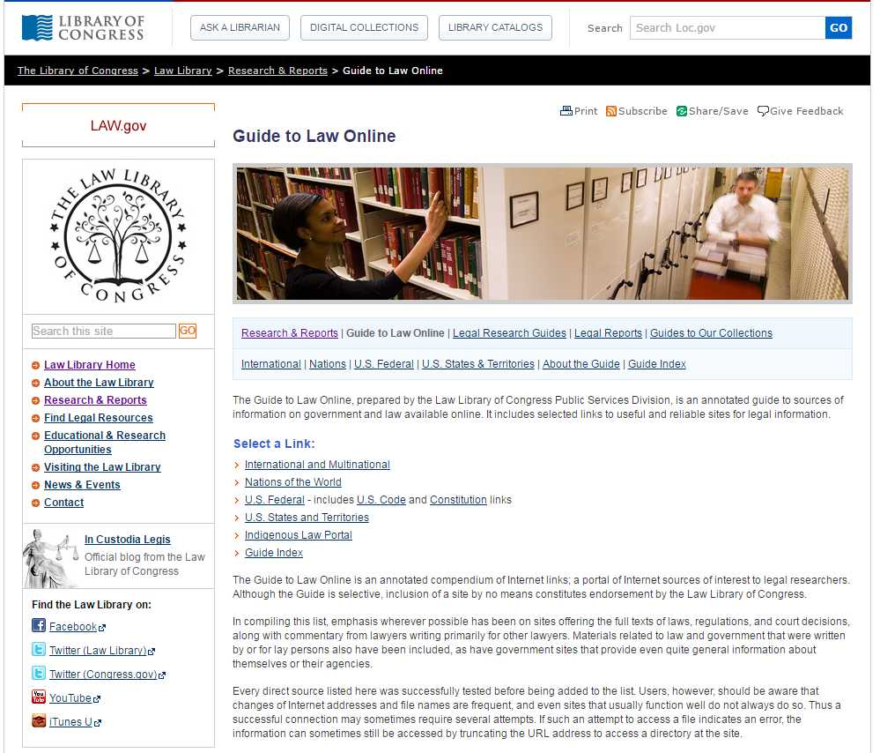
#10 Law Library of Congress

Slide 7
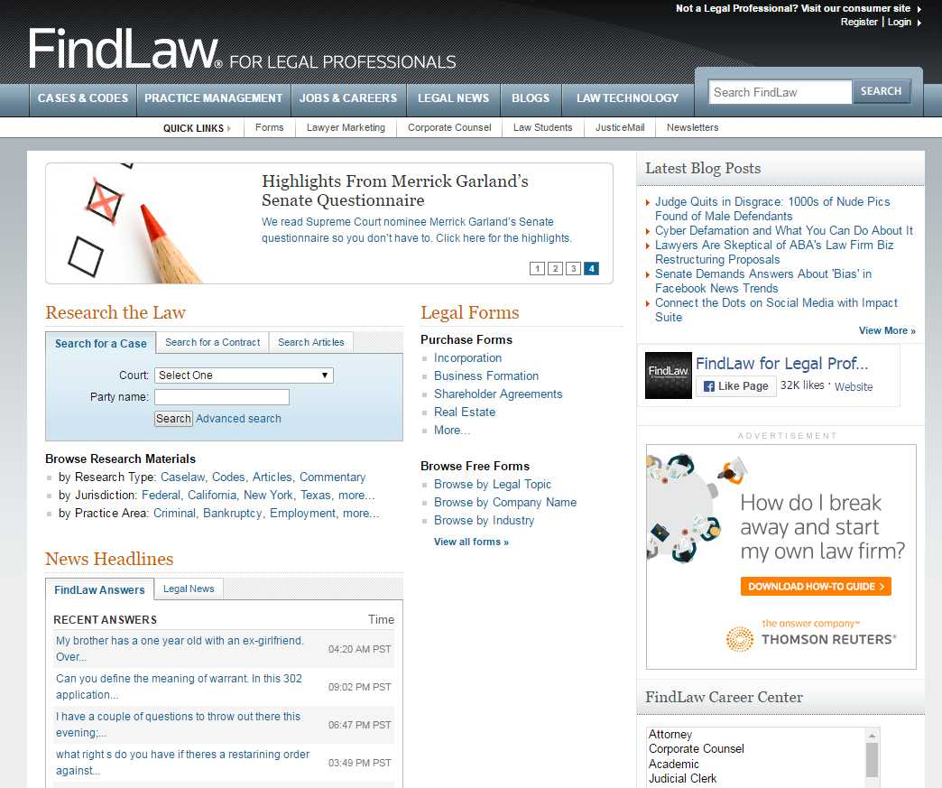
#9 Findlaw for Legal Professionals

Slide 8
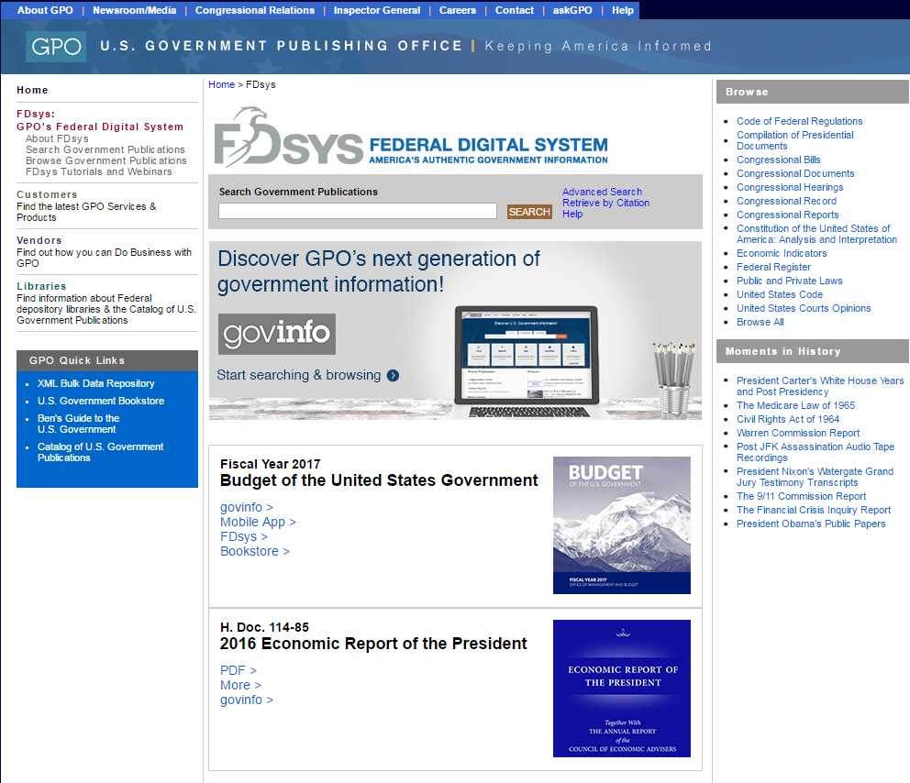
#8 FDSys – going to be govinfo.gov

Slide 9
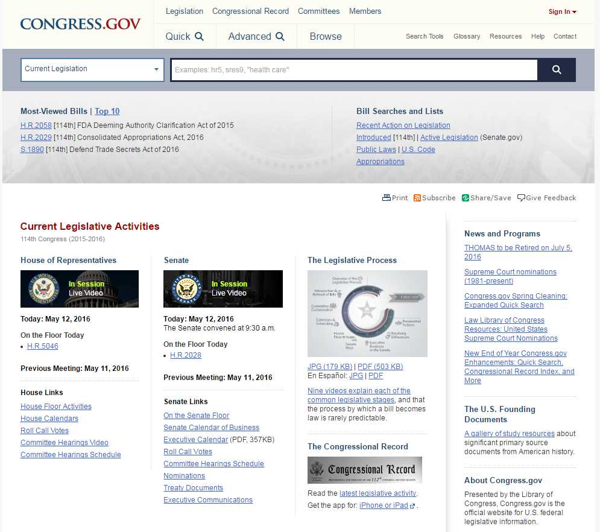
#7 Congress.gov

Slide 10
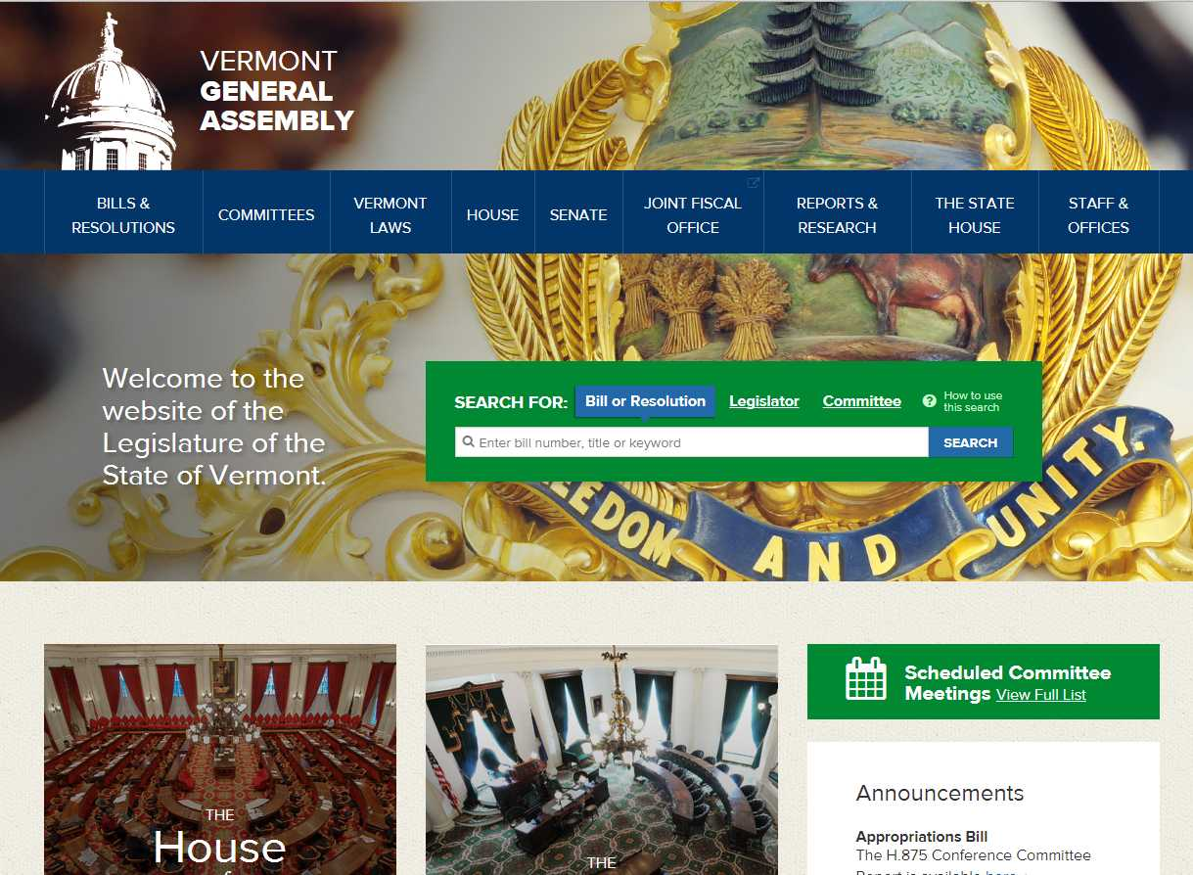
#6 Vermont State Legislature

Slide 11
#5 Vermont Judiciary

Slide 12
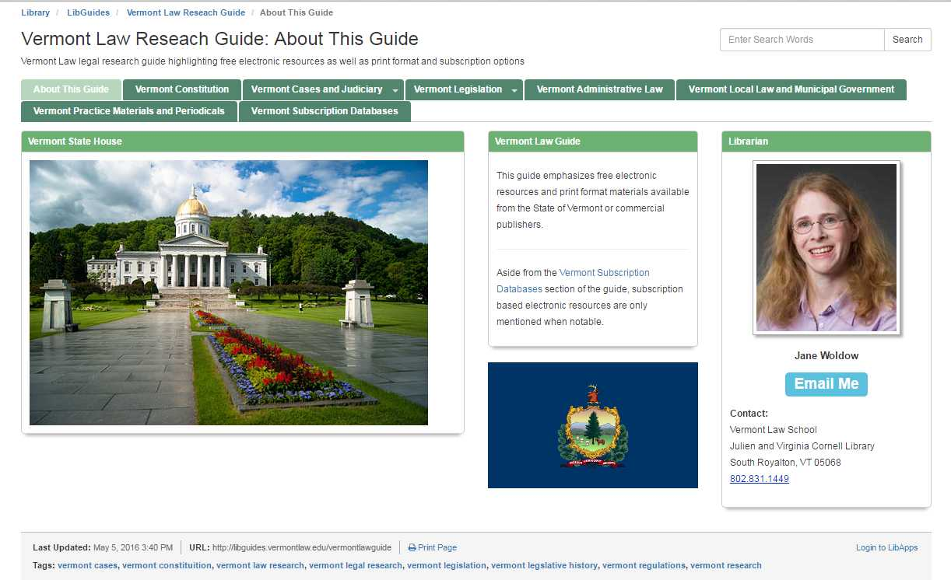
#4 Vermont Law Research Guide

Slide 13
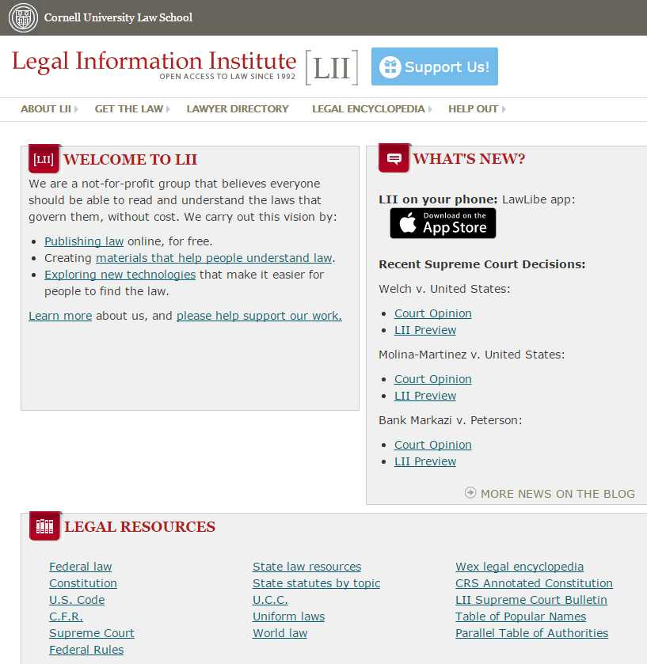
#3 Cornell’s Legal Information Institute

Slide 14
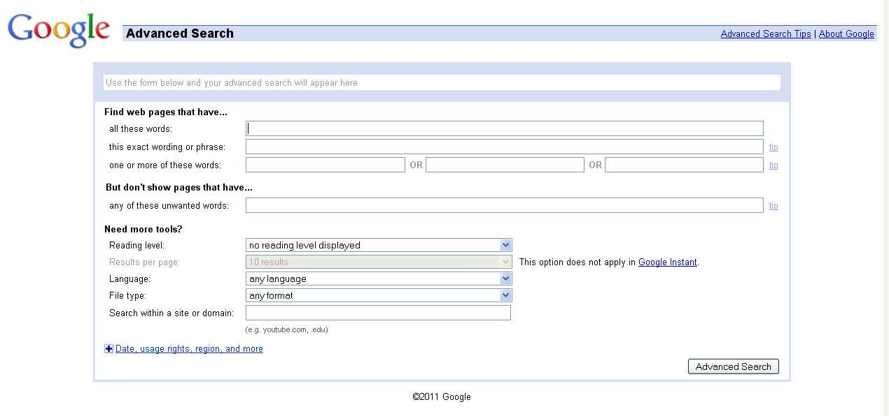
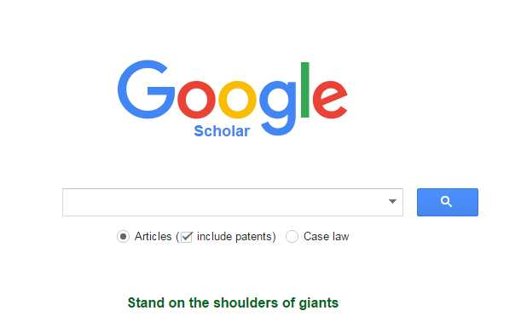
#2 Google Scholar

Slide 15
#1 Network of Librarians!
Cynthia Lewis
Library Directory & Assistant Professor
Vermont Law School
802.831.1444
clewis@vermontlaw.edu
Natalia May
CLIC Coordinator
Vermont Law School
802.831.1440
namay@vermontlaw.edu

