Slide 1
Social Media for Your Library
Kirsten Hansen, Aldrich Public Library
Lisa Buckton, Fletcher Free Library
Kelsey Psaute, Burnham Memorial Library

Slide 2
Your Panelists
Kirsten
Facebook – Aldrich Public Library
Twitter – @AldrichLIbrary
Lisa
Facebook – Fletcher Free Library
Twitter – @FFLteenspace
Kelsey
Facebook – Burnham YA
Twitter – @BurnhamYA
Instagram – burnhamlibraryya
Tumblr – yaburnhamlibrary.tumblr
Instagram – FFLteenspace

Slide 3
Social Media as Outreach Tool
“Why is social media useful?”

Slide 4
Why Do This?
Internet visibility! Participation in the Digital Age!
Humanizing presence
  Are your librarians serious types? Into cats?
  (cat memes still win the internet)
Library recognition and personality
  Great kids programs? A new circulating collection? An innovative partnership with a local organization? Your town’s art hub? Quiet destination?
  It will always be marketing- telling your community about the great things happening in your library is not a bad thing!
Notes:
Internet visibility -“Patrons can interact with the library even when they aren’t in the building”
Library recognition -“Social media can help you tell all those stories”.
Your library can have fun on your social media and combat the image of the “shushing library”...librarians are humans too!

Slide 5
Platform by Platform
“So what is social media anyway?”

Slide 6




Patron Engagement, Action, and Consumption
Facebook
Instagram
Snapchat
Twitter
Video and image engagements
Quick visual engagements
Quick “verbal” engagements
Messaging
Pictures
Follow authors
Hashtag sorting
Hashtag sorting
Only visible to followers
Visual competitions
Events
Pictures and tags
“send” the message
Notes:
Definition: the big ones that most people have heard of, tend to use, and are fairly familiar with interacting on. These are the must-haves or must-try’s for every library because they allow for the greatest engagement rewards.
Facebook
possibly the most common library social media: if your library has a website, it needs a Facebook page
connects to personal account; can toggle between personal and professional pages
Able to create events under the umbrella of your organization; also a good tool for pictures of library events (cute kids win, so long as you have parent permission to post) and for fun posts.
Twitter
Lisa story: Danya Lorentz
Kelsey story: Andrew Smith/Andy Weir/Sharon Biggs Waller skyping for free
Instagram
quick visual engagements
#bookface
Competitions to promote library events #blinddatewithabook
Snapchat
Another Kelsey fail
Useful IF you can get patron buy-in and “friends”

Slide 7
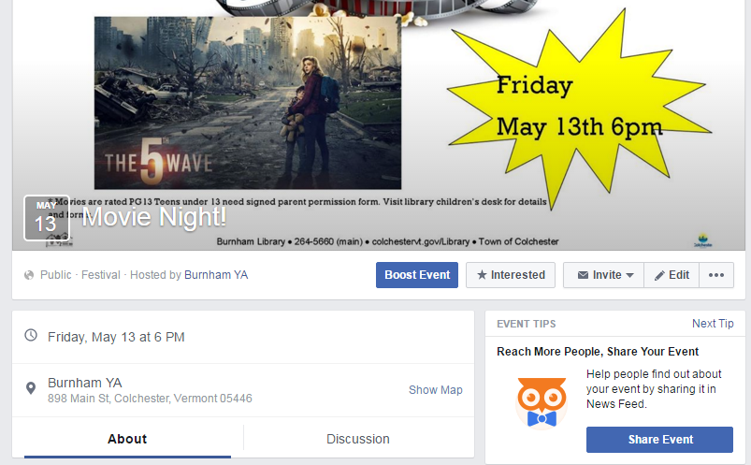
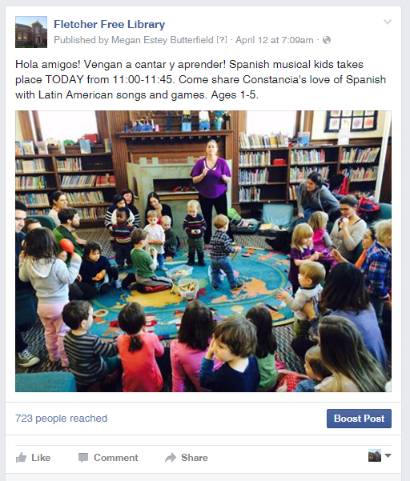
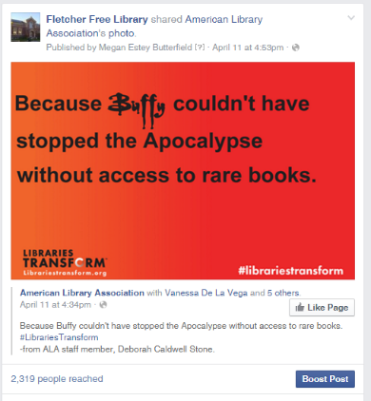
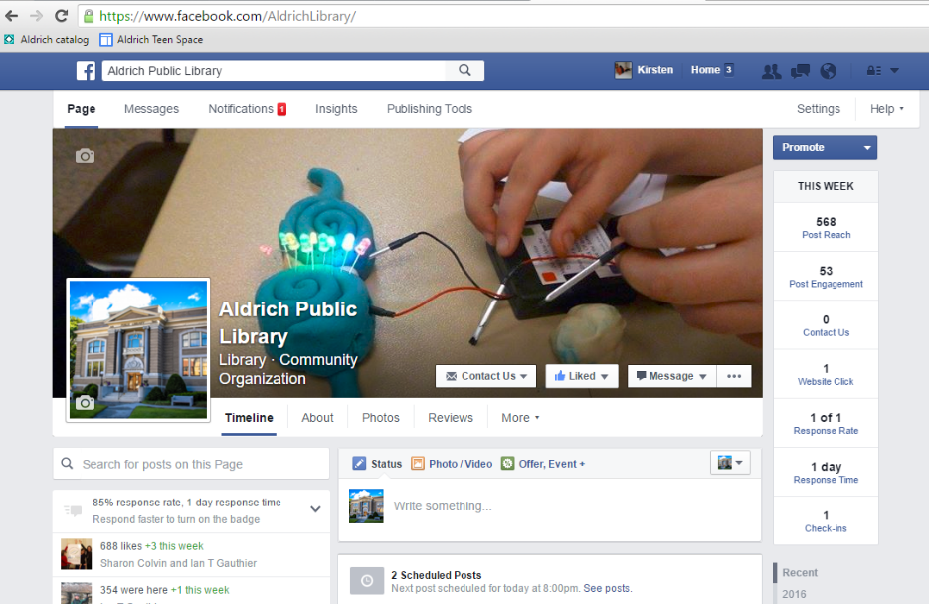
Facebook in Action

Slide 8
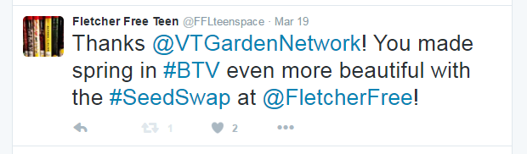
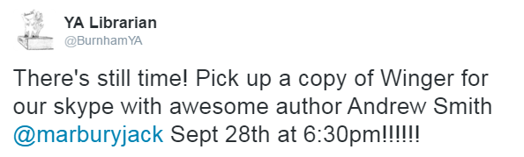
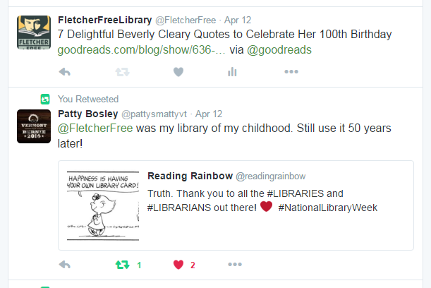
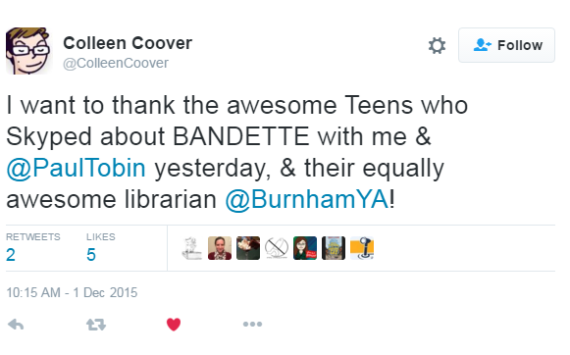
Successful Tweets
Quick pitches that include all necessary information
Acknowledge contributors and feedback
Connect with the larger community of authors and libraries and patrons

Slide 9
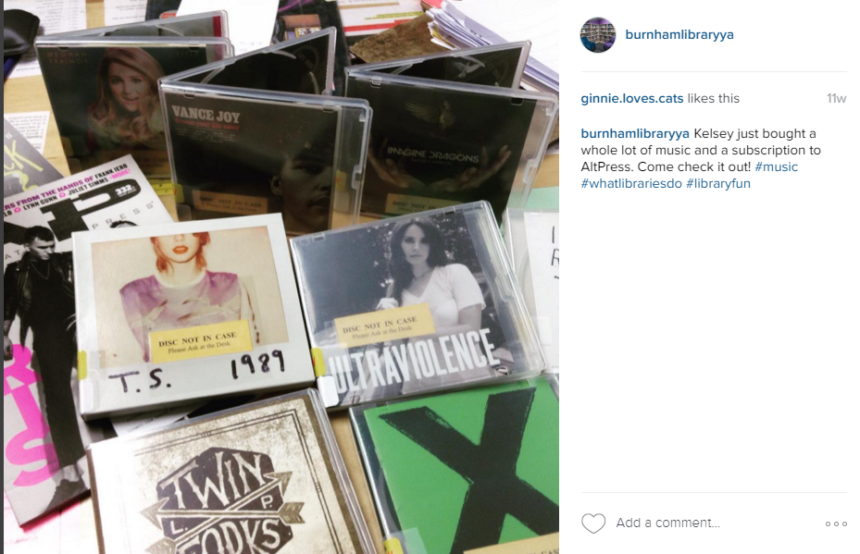
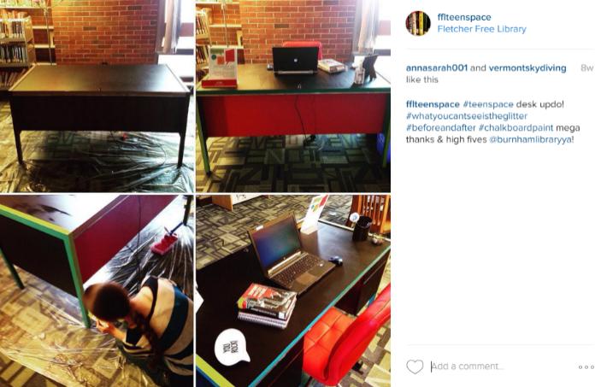
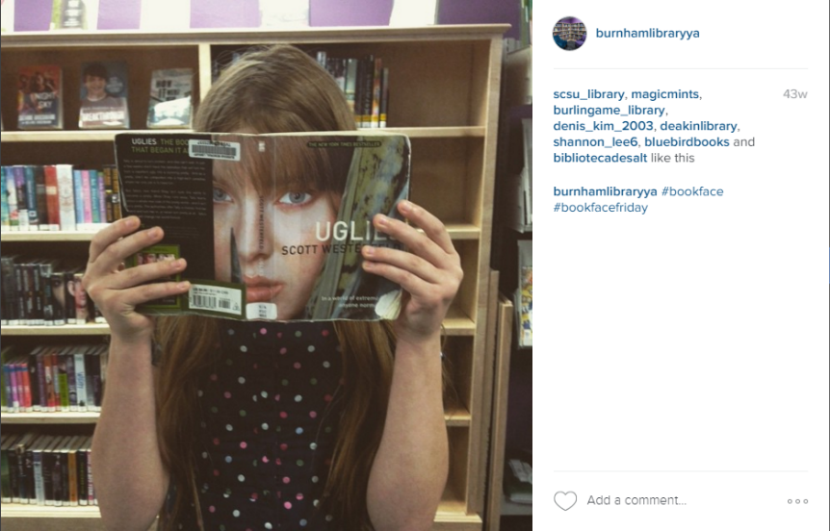
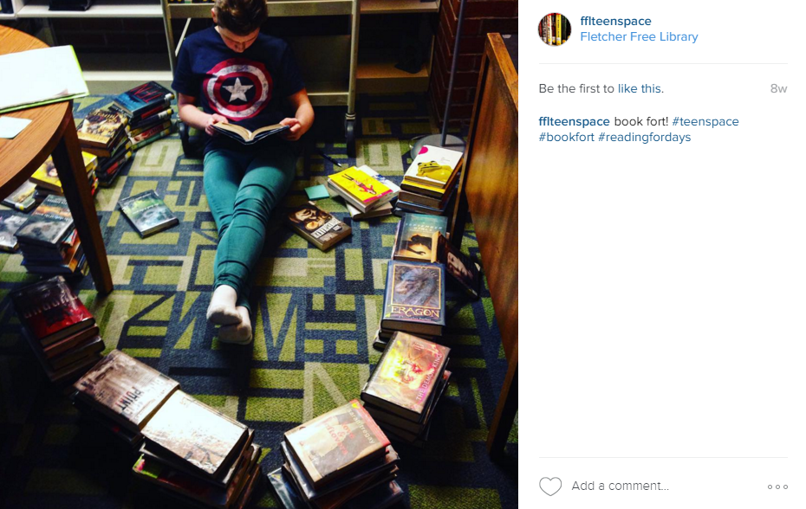
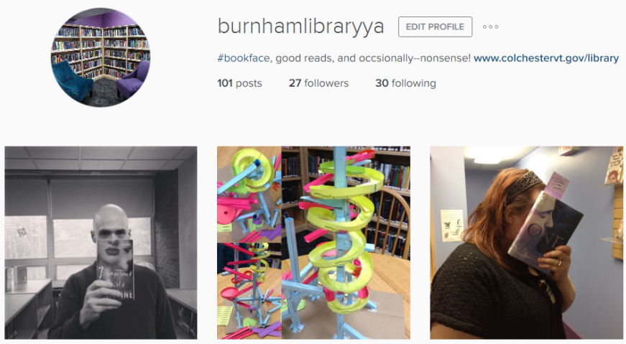
Instagram

Slide 10



Patron Consumption and/or Discovery
Google+
Tumblr
Pinterest
Ideal for visual learners and idea gathering
Social blogging and trendy internet memes
Most google users already have it
Notes:
Definition: it might be nice to have an account for the purposes of information gathering, which is how most users are interacting on these. The most engagement you can get is someone theoretically viewing your content in their feed and ‘liking’ it.
Google+
an example of a social network that didn’t take off but that had a lot of buzz early on: not all social media platforms are forever but it’s worth seeking out what your library users are engaged with
Tumblr
Used by a lot of larger libraries and academic libraries
Where you find allll the memes and ‘trends’ in YA lit
Might interact with other libraries and authors
Users can ‘ask’ your page a question
Pinterest
useful in-house and to use as a “investigate later” landing page
Ideal for visual learners

Slide 11
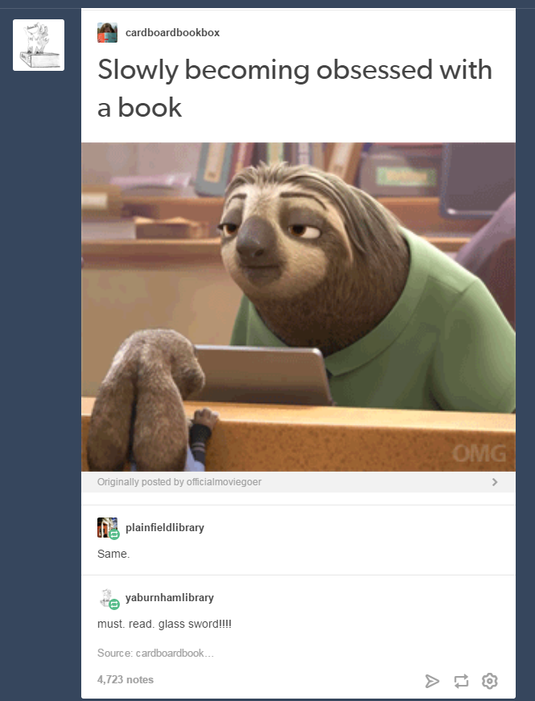
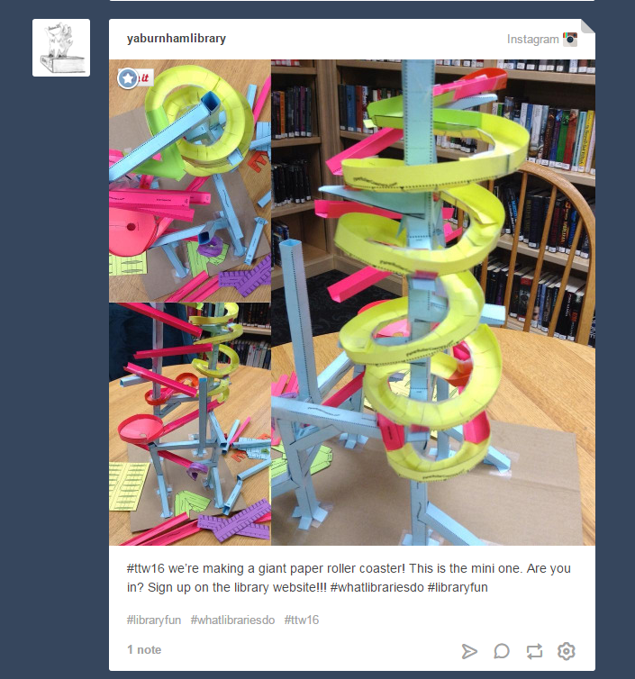
Tumblr

Slide 12
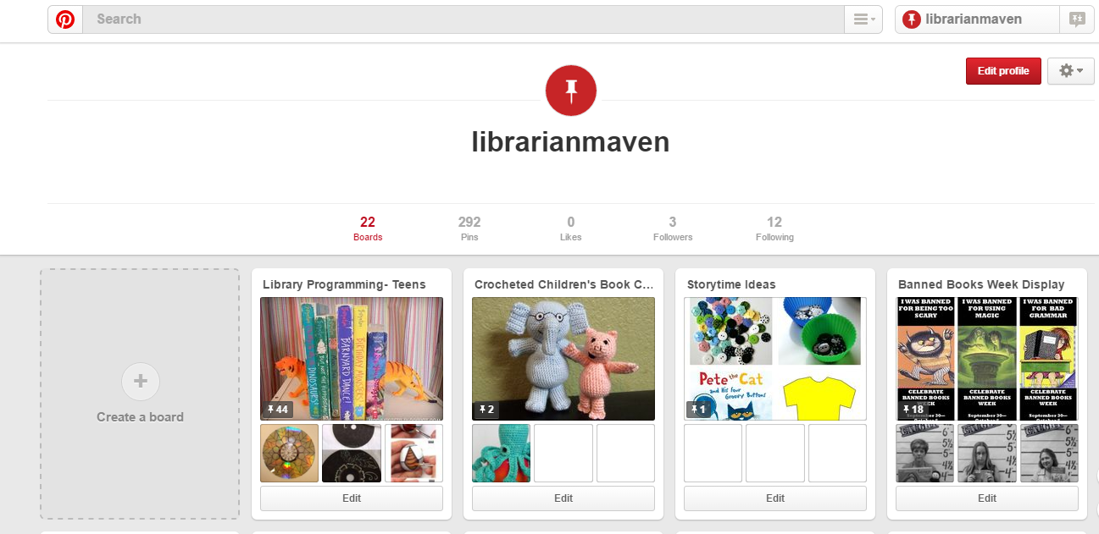
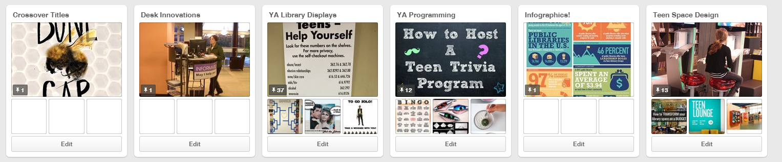
Pinterest

Slide 13



Embeddable Assets
Pearltrees
A visual organization of media for display
Includes websites, photos, documents, and text in one format
LibraryThing
Keep track of books as a reader’s advisory
Showcase books with cover images
Goodreads
Keep track of books and reviews
Display public “shelves”
These social media platforms are most useful as they interact with your “main” accounts i.e. your Facebook presence, library website, and as tools for sending media messages elsewhere.
Notes:
Definition:
Pearltrees
Kelsey uses as website embed to ‘display’ collections of links more visually
users can “follow” various trees to “save” them for later
LibraryThing
the Aldrich uses librarything as a widget on our website to showcase new books each month
Kirsten uses it as a personal readers advisory tool to keep track of what she reads, with tags, so that she can find books later. Great for kids who need very specific books for book reports!
GoodReads
Widget option
Kelsey uses the widget on website to have a ‘shelf’ of GMBA books on library page
Integrates well with FB
Followers, access to book lists and reviews

Slide 14
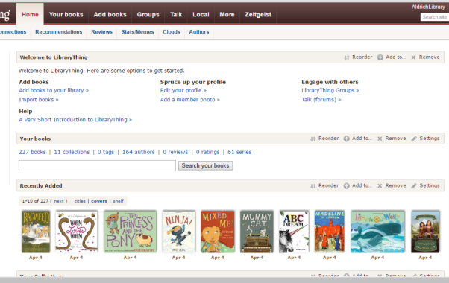
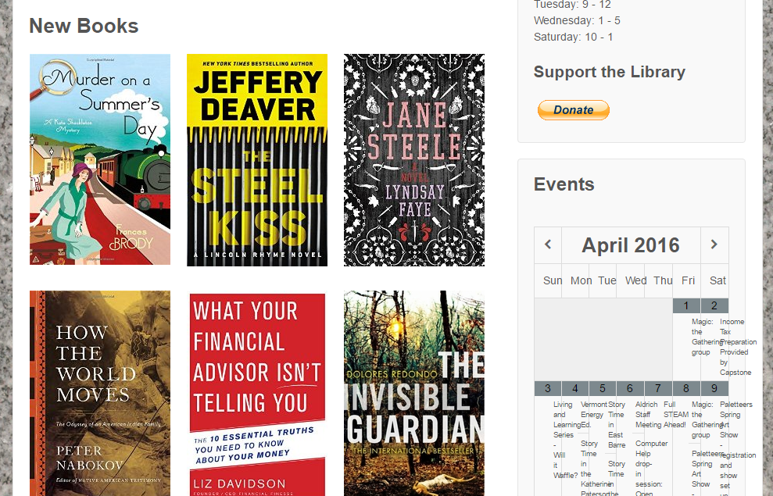
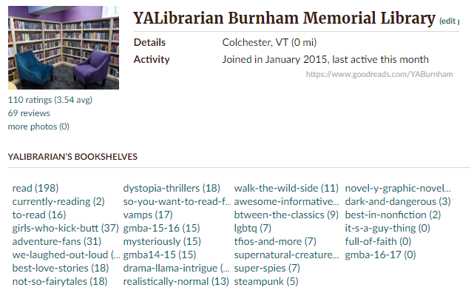
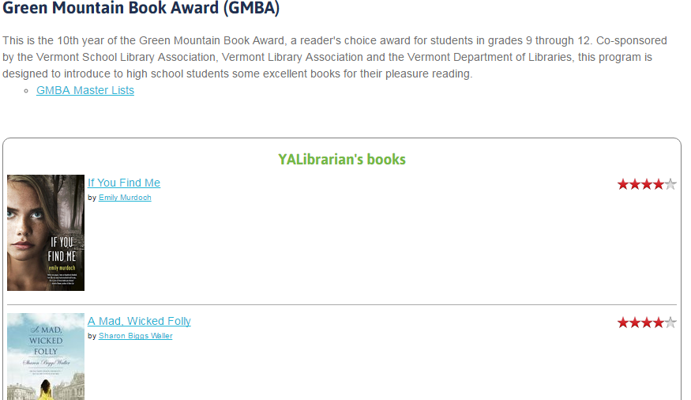
Embedded Assets

Slide 15
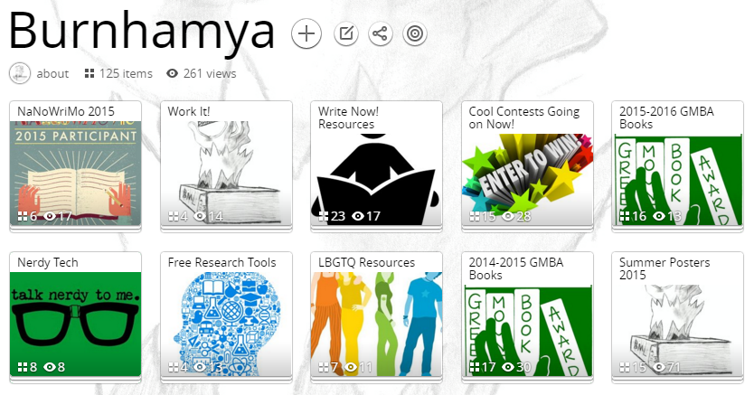
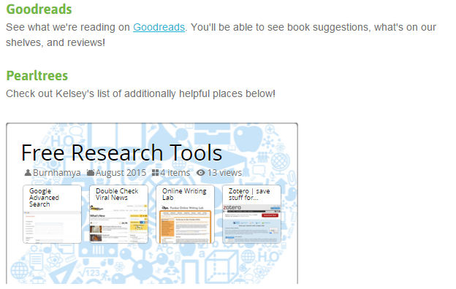
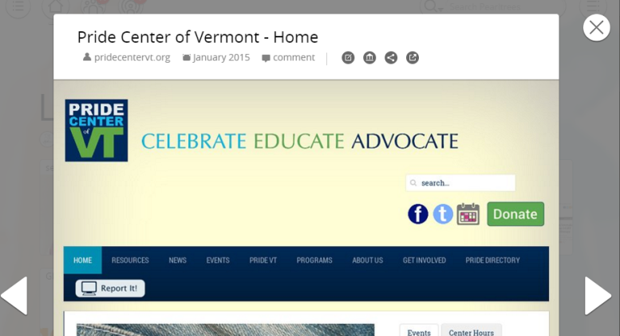
More Embedded Assets

Slide 16
Data Doesn’t Lie
“Is it all worth it for me?”

Slide 17
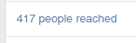
The Numbers
Most social media platforms have a way to track your engagement
24% teens (13-18) are online via mobile device almost constantly (Lenhart)
92% teens report going online at least once daily (Lenhart)
76% of all internet users have at least one social media account (Perrin)
65% of adults have at least one social media account (15% are otherwise offline) (Perrin)
“There are not notable differences by racial or ethnic group” and “58% of rural residents, 68% of suburban residents, and 64% of urban residents use social media” (Perrin)
Lenhart, Amanda. "Teens, Social Media & Technology Overview 2015." Pew Research Center Internet Science Tech RSS. N.p., 07 Apr. 2016. Web. 28 Apr. 2016.
Perrin, Andrew. "Social Media Usage: 2005-2015." Pew Research Center Internet Science Tech RSS. N.p., 07 Apr. 2016. Web. 28 Apr. 2016.

Slide 18
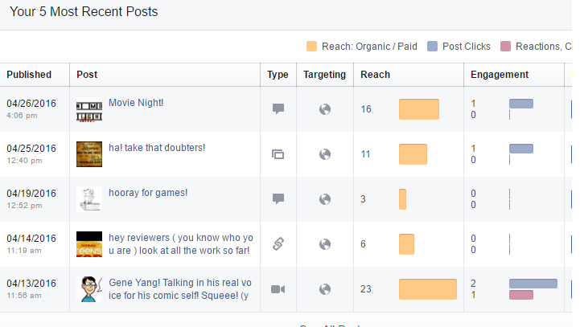
Facebook Analytics
In the admin view of your facebook page, you can investigate how your posts are doing and what types of posts or post times perform better!
Every community has different successes and failures

Slide 19
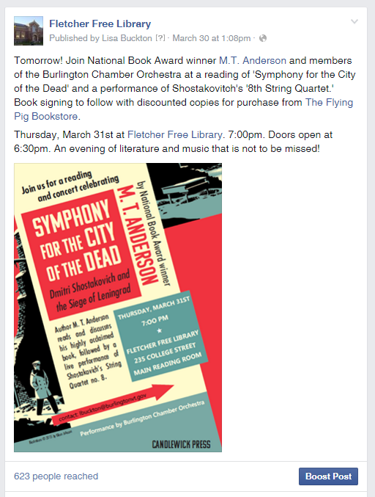
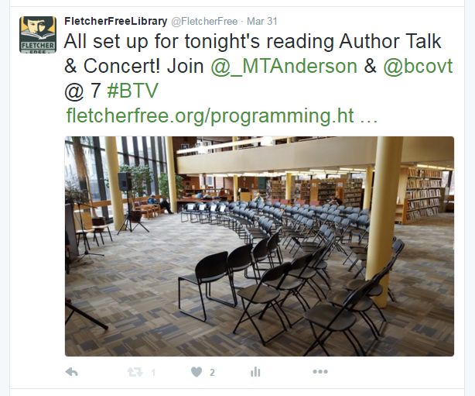
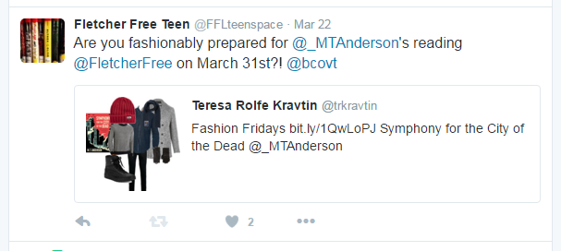
Message and the Medium
Differing social media platforms warrant a difference in the content of the message.
Different communities utilize different media at different times of day and in different ways

Slide 20
Some Notes on Failure…
It happens. It’s okay. You learned something!
Not everything works in every community
You will have to experiment to figure out your own best practices
Notes:
Kelsey’s Snapchat after her YAAB asked for it!
Events that were posted and didn’t get participants

Slide 21
Practical Applications
“How does this benefit my library?”

Slide 22
Help Everyone
Claim or choose an easy, recognizable account name
  Ideally, this name is the same across all accounts
Decide when you will post
  Scheduled? Spontaneous? ‘Themed’ Days?
Instant access to what other libraries are up to
Join beneficial groups of librarians
  Vermont Libraries as Makerspaces, Vermont Teen Librarians, Storytime Underground, Minecraft in Libraries, etc.
Community outreach with other local groups
Notes:
Choosing/claiming a good account name
potentially worth ‘claiming’ your library’s name just to avoid not having control of hate accounts
Scheduled vs. spontaneous
should you schedule your posts (as available on some media) OR set aside time for yourself in your schedule to post regularly
FB groups as place to ask other librarians questions instantly (Vermont Libraries as Makerspaces, Minecraft in Libraries, Libraries and Social Media, Storytime Underground)
Community/town/city outreach
Partnering and communicating with local and community organizations
Police department; Parks & Rec; Senior Center
Spectrum, The Generator, Young Writers Project
Continuing conversations inside and outside of the library interaction
Outreach even for people who live outside your local community- for example, we get genealogy requests via Facebook message

Slide 23
Policy Notes
If you don’t have a social media policy, you need one!
Check your town/library’s social media policy for guidance on:
  Patron interactions
    who gets to ‘friend’ your professional accounts?
    interactions with minors (13-18) friends, likes, follows, etc.
  Responding to trolls and other public comments
  Your role(s) in maintaining a social media presence
Notes:
town/library social media policy
Kelsey has Burnham’s as example if needed

Slide 24
Questions?

Slide 25
Make Your New Mark
Tweet:
Just finished (title) with @burnhamya, @FFLteenspace, & @aldrichlibrary at #VLA2016 #whatlibrariesdo #awesome
Post:
Capture:
Reaching out in style after “Social Media in Your Library” with BurnhamYA, Fletcher Free Library, and Aldrich Public Library at #VLA2016
#instafun, #bookfacefriday, #libraryfun
Notes:
ok. shameless promotion of us: what if we had a 'sample' posting on each platform ready for them to 'borrow' as their first one--or first re-vamped one that went something like: I just attended (program) and m(library) welcomes you to our new (platform) account!" too lame?
FB Post (picture and text)
Tweet and tag
A bookface or other instagram picture

