Slide 1
The ADA and Libraries
Stacy Hart, Training and Information Specialist
New England ADA Center
Institute for Human Centered Design
200 Portland St. Boston, MA 02114
800-949-4232 voice/tty
Notes:
rev. 1/96

Slide 2
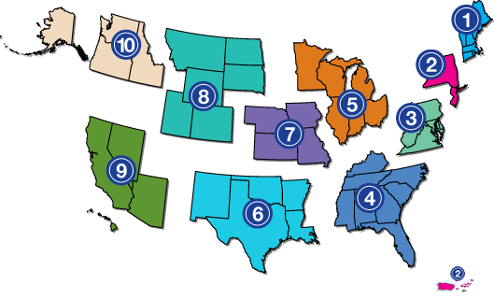
New England ADA Center
member of
1-800-949-4232 voice/TTY
Funded by the National Institute on Disability and Rehabilitation Research
Notes:
Not an enforcement agency

Slide 3
A Project of
Institute for Human Centered Design
An international design non-profit dedicated to enhancing the experiences of people of all ages and abilities through excellence in design
www.HumanCenteredDesign.org
Notes:
Located in Boston; Come visit

Slide 4
Goals
Understand ADA obligations
Provide good customer service to people with disabilities
Notes:
rev. 1/96

Slide 5
Pop Quiz
How many people living in the United States have a disability?
Notes:
rev. 1/96

Slide 6
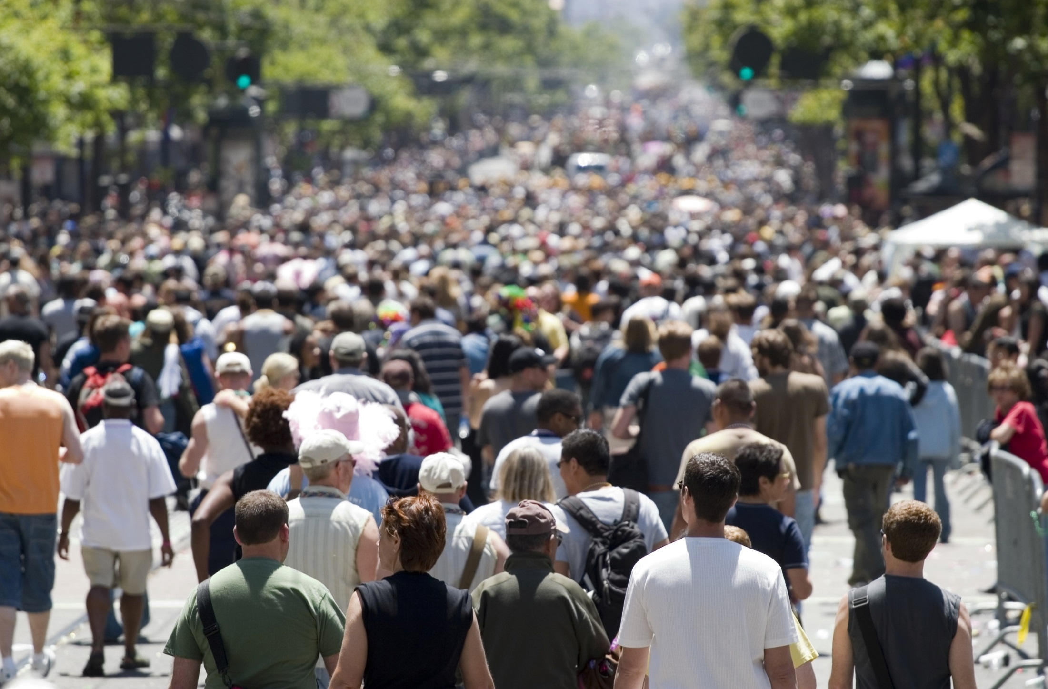
Prevalence Rates
56.7 million
self-identified as people with disabilities
- 2010 US Census
Notes:
In the USA, 15% of people are born with disabilities and 85% acquire disabilities in a lifetime.
People that disclose.
1 in 5 people who are living with at least one disability, and most Americans will experience a disability some time during the course of their lives. Think of what the number would be if we could include all of the people who did not disclose
6

Slide 7
Pop Quiz
How many people age 65 and older currently live in the United States?
43.1 Million
(13.7 % of the US Population)
Notes:
rev. 1/96

Slide 8
Everyday 10,000 people in the US are turning 65 years old
Notes:
And still work and be active. To continue to 2031. The reality as we know it is that the incidence of disability increases with age.
Picture of disability changes with age-youth with disabilities are more like to have brain based disabilities
8

Slide 9
Most common reasons for functional limitation of adults in the US...
Arthritis
Back problems
Heart disease
Respiratory disease
Diabetes & related conditions
Hard of hearing
25 M Americans report difficulty walking, yet only
3.4 M Americans use wheelchairs or scooters, projected to grow to 4.3 in 2030

Slide 10
Most prevalent types of disabilities for children in the US… 13.1% of all youth age 3-21
80% are based in the brain
Specific learning disabilities 4.9%
Speech or Language impairments 2.9%
Other health impairments* 1.9%
Intellectual disability .9%
Emotional disturbance .8%
Autism .8%
Developmental delay .7%
US DOE National Education Statistics(2012) for 09-10
* “Other health impairments” include having limited strength, vitality, or alertness due to chronic or acute health problems
Source:
U.S. Department of Education, National Center for Education Statistics (2012) for years 2009-2010

Slide 11
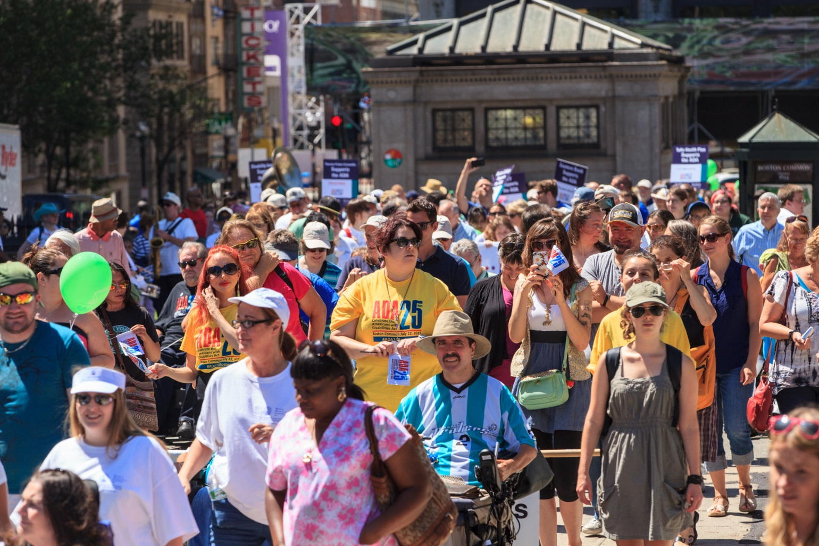
The ADA protects those who self-select as people with disabilities

Slide 12
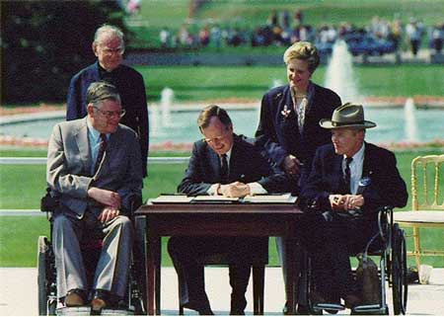
Americans with Disabilities Act
Provide a clear and comprehensive national mandate for the elimination of discrimination against people with disabilities
Notes:
The American with Disabilities Act (ADA ) as amended is a civil rights law that prohibits, discrimination based on disability.
The ADA covers a wide range of disabilities, from physical conditions affecting mobility, sight, hearing, and speech to conditions such as learning disabilities.
Signed into law on July 26, 1990
rev. 1/96

Slide 13
Structure of ADA
Title I – Employment
Title II – State and local governments
Title III – Places of public accommodation
Title IV – Telecommunications
Title V – Miscellaneous
www.ada.gov
Notes:
What town/city are you from?
Does everyone work for a council on aging

Slide 14
Applies to all Library Services
Computers
Classes-Microsoft Office, social media, digital photo
Art Exhibits
Open Mic
Book Club
Poetry
ELA Classes
Conversation Groups
Art Classes
Story Time/Rhyme Time
Gaming
Museum Passes
Book Sales
Job Searches
Movie Night
Clubs-anime, creative writing, lego

Slide 15
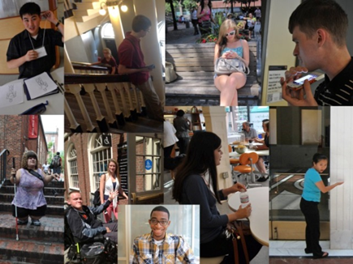
Snapshot of Disability
Notes:
The American with Disabilities Act (ADA ) as amended is a civil rights law that prohibits, discrimination based on disability.
The ADA covers a wide range of disabilities, from physical conditions affecting mobility, sight, hearing, and speech to conditions such as learning disabilities.
Signed into law on July 26, 1990

Slide 16
ADA
Definition of Disability
A physical or mental impairment that substantially limits one or more major life activities
A record of such an impairment
Being regarded as having such an impairment

Slide 17
ADA Definition of Disability
A person who has
a physical or mental impairment that substantially limits a major life activity

Slide 18
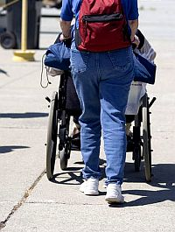
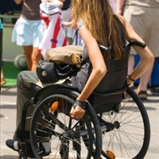
People with Mobility Disabilities

Slide 19
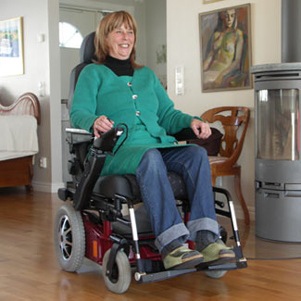
People with Mobility Disabilities

Slide 20
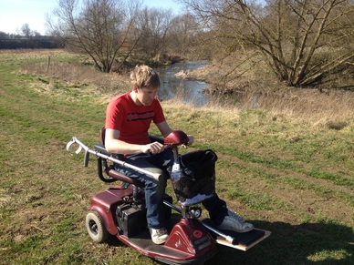
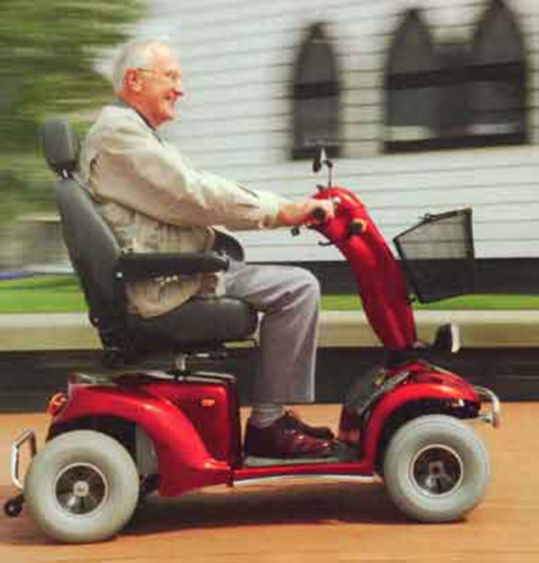
People with Mobility Disabilities

Slide 21
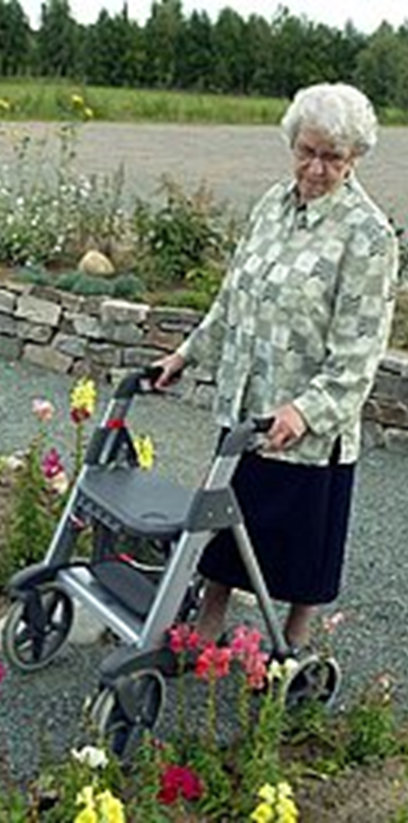

Slide 22
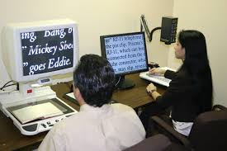
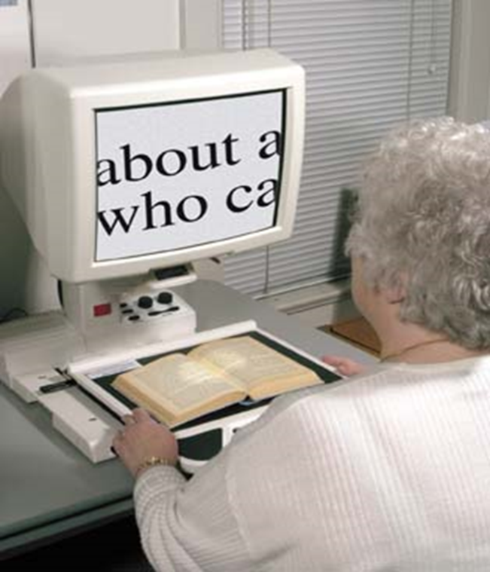
People with Low Vision

Slide 23
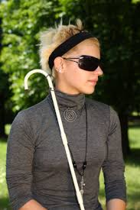
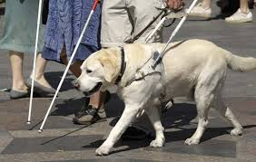
People Who Are Blind

Slide 24
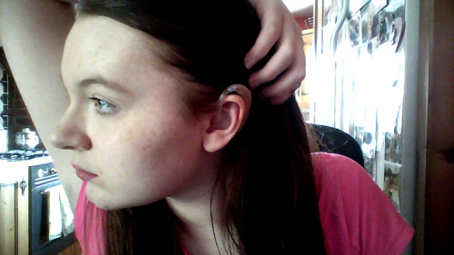
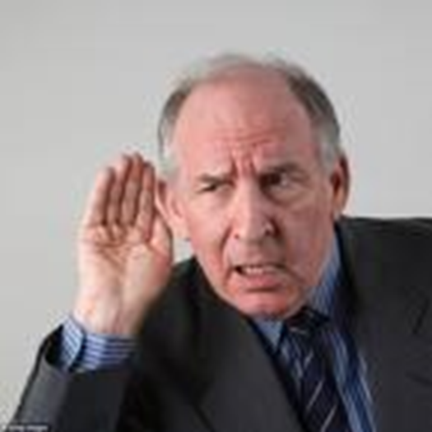
People Who Are Hard of Hearing

Slide 25
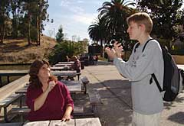
People Who Are Deaf

Slide 26
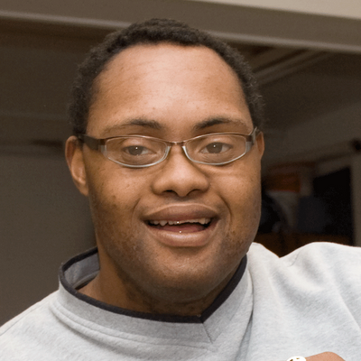
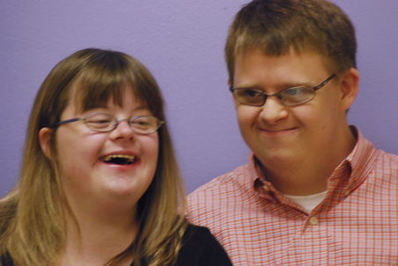
People with Intellectual Disabilities

Slide 27
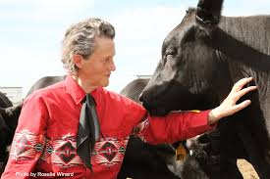
People with disabilities that may or may not be apparent
Alcoholism
Autism
Epilepsy
Psychiatric illness
Tourette syndrome
Traumatic brain injury

Slide 28
People with Non-apparent Disabilities
ADHD
Celiac Disease
Diabetes
Cancer
Heart disease
HIV
Learning disabilities
Multiple chemical sensitivity
Notes:
85% of people with disabilities have a brain based disability
40% of incoming freshman have a learning disability
1 in 25 undergraduate students
Examples: Dyslexia, Dyscalcula, visual processing, audio processing, nonverbal learning disability

Slide 29
Statistics
700,000 people have Crohn’s Disease.
1.5 million people have Lupus.
1.66 million people are diagnosed with cancer each year; (2012).
2.4 million students are diagnosed with specific learning disabilities.
52.5 million people have arthritis.

Slide 30
People with Mental Health Disabilities
1 in 5 adults in the U.S.—43.8 million experiences mental illness a year.
1 in 25 adults in the U.S.—a serious mental illness that would be considered a disability under the ADA.
Among the 20.2 million adults in the U.S. who experienced a substance use disorder, 50.5%—10.2 million adults—had a co-occurring mental illness.

Slide 31
Three broad categories of functional limitation:
Physical Mobility Dexterity Strength Stamina
Sensory Sight Hearing Speech Touch
Brain-based Learning Developmental Mental health Cognitive
Notes:
Creating different access points
A way of looking at disability which allow to work to ensure that the maximum number of people can participate

Slide 32
End of Aging Population and Disability
Next Ensuring Effective Communication

Slide 33
Effective Communication
Notes:
rev. 1/96

Slide 34
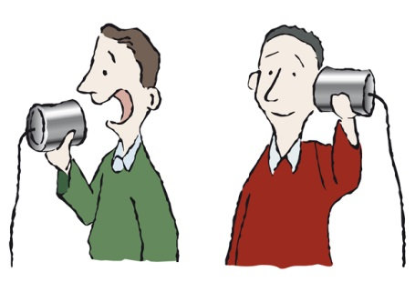
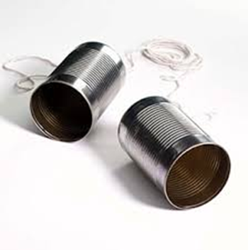
ADA Effective Communication
Ensure that communication with people who have disabilities is as effective as communication with others

Slide 35
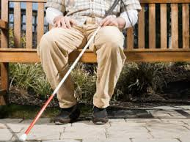
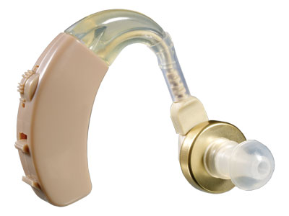
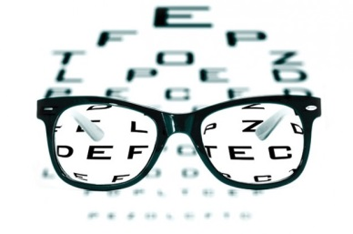
Effective Communication
People who :
are blind or visually impaired
are deaf or hard of hearing
or
have a speech disability

Slide 36
People Who Are Blind or Have Low Vision
Notes:
rev. 1/96

Slide 37
Scenario + Discussion
Your library is sponsoring a poetry reading. You will be handing out a program with the names of the poets and their poems. You receive a call from a person who is blind who requests that the program be provided in Braille.
You
Tell him your library doesn’t provide that service
Send an email to your supervisor
Contact the town’s ADA Coordinator
Make arrangements for the program to be Brailled (where??)

Slide 38
Effective Communication
Auxiliary Aids and Services
Businesses, non-profit organizations, state and local governments must provide “auxiliary aids and services”
If necessary to ensure effective communication

Slide 39
Provide material in Braille

Slide 40
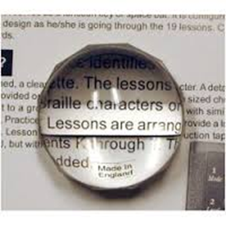
Scenario + Discussion
Mr. A will be participating in a workshop at your library.
He has macular degeneration and his vision isn’t as good as it used to be.
He requests workshop material in 54 point font.
What is your library’s obligation?

Slide 41
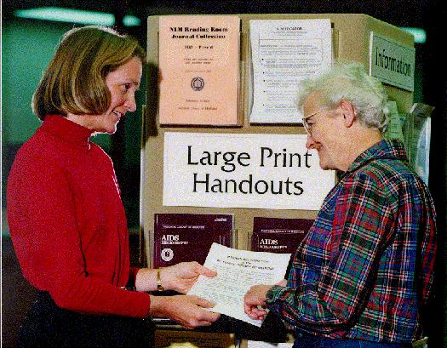
Provide material in Large Print
If individual makes request, provide in whatever size the person needs
For general use provide in 18 point font

Slide 42
Magnifier

Slide 43
Provide print material, thumb drive or email it

Slide 44
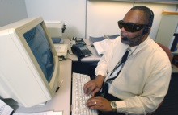
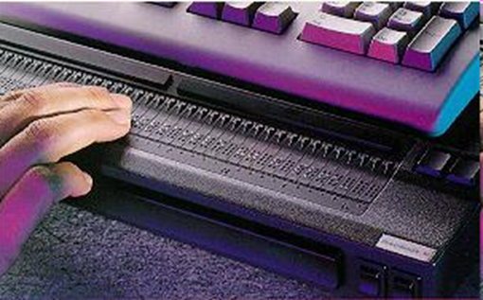
Many people who are blind use screen reading technology
With audio input & output
With refreshable Braille

Slide 45
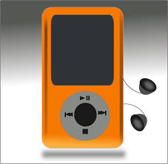
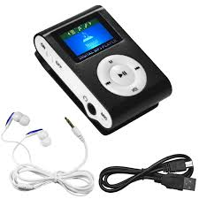
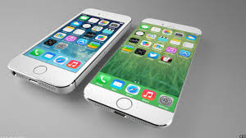
Provide material in audio format
Notes:
- Maybe list the sound format here .Wav, .mp3
image of an I-phone

Slide 46
e-reader
http://www.ada.gov/sacramento_ca_settle.htm

Slide 47
Does your library have computers that the public uses? Is screen reading software installed on at least one computer?

Slide 48
NVDA (NonVisual Desktop Access)
Free “screen reader”
Enables people who are blind to use computers
Reads the text on the screen in a computerized voice
Can download to computer and/or thumb drive www.nvaccess.org

Slide 49
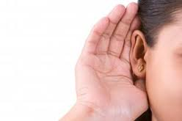
People who are Deaf or Hard of Hearing

Slide 50
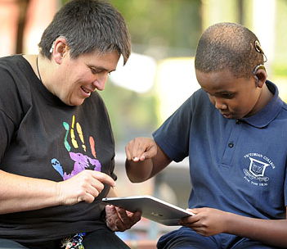
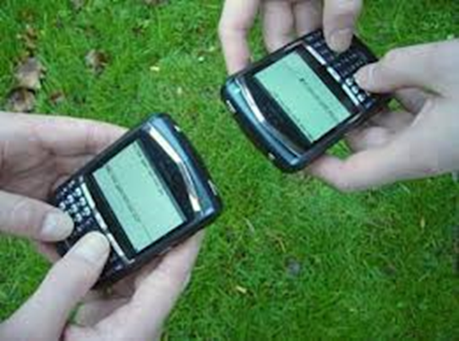
Use What You Have to Communicate
Try written notes
Texting
Typing at a computer

Slide 51
Scenario + Discussion
You receive an email from a man who is hard of hearing requesting an assistive listening device so that he can participate in a lecture.
You should:
Give the request to the director
Tell the person your library doesn’t provide assistive listening devices
Arrange for the device (where, how?)
Other

Slide 52
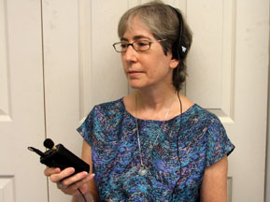
Assistive Listening Devices Amplify Sound for an Individual

Slide 53
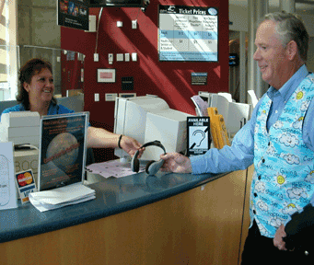
ALDs Available Note the Sign

Slide 54
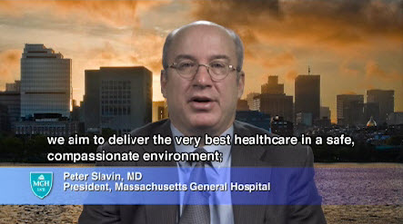
Closed or Open Captions on Video

Slide 55
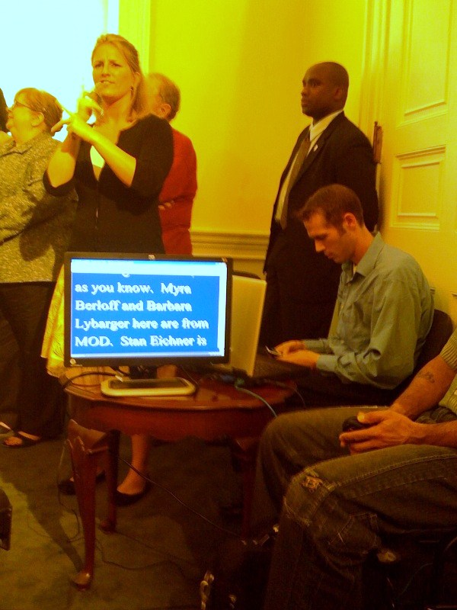
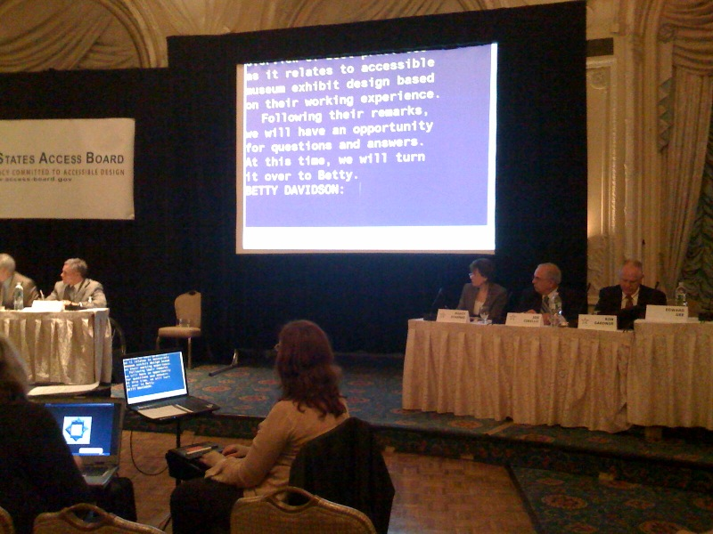
Computer Aided Real-time Transcription CART

Slide 56
Now the library receives an email from a woman who is deaf and would like a sign language interpreter provided for a lecture.
ADA regulations suggest a family member is the most appropriate person to provide sign language interpretation in this situation.
True or False?

Slide 57
No…
The interpreter needs to be qualified:
“Able to interpret effectively, accurately, and impartially, both receptively and expressively, using any necessary specialized vocabulary.”

Slide 58
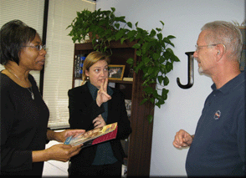
When using a sign language Interpreter face and look at the person who is deaf.
Interpreter
Person who is deaf
You
https://www.youtube.com/watch?v=8YXyTNIdux4

Slide 59
Ensuring effective communication in a group
Woman in brown shirt is deaf, interpreter is standing
2.4
Notes:
2.4

Slide 60
How do people who are deaf or have speech disabilities communicate by phone?
Telecommunications Relay Service (TRS)
TTY
Video phone
Internet
Caption phone
Notes:
permit persons with a hearing or speech disability to use the telephone system via a text telephone (TTY) or other device to call persons with or without such disabilities.
People who are deaf or hard of hearing
People who can hear but can’t speak or have a speech impediment

Slide 61
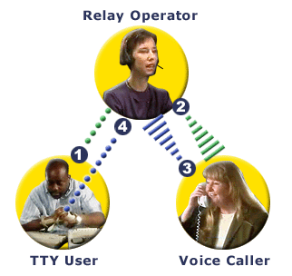
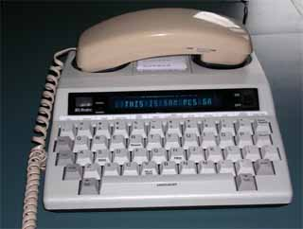
TTY and Relay
Notes:
permit persons with a hearing or speech disability to use the telephone system via a text telephone (TTY) or other device to call persons with or without such disabilities.
People who are deaf or hard of hearing
People who can hear but can’t speak or have a speech impediment
funded through the Interstate Telecommunications Relay Services Fund and overseen by the FCC.
Free to users

Slide 62
Relay Service
"Hello, this is the Relay Service. Have you received a relay call before?”
“This is operator (or communication assistant) number________. I have Jane Doe on the phone.”
Don’t hang up!

Slide 63
Relay Service
The "GA" stands for Go Ahead -- Use "GA" whenever you have finished what you are saying,
To end the call, type SK ("Stop keying"). The person will respond by "SK" if he/she agrees.
There will be brief silences as the operator types to the TTY user and the user replies.
Notes:
Push the “ON” switch.
Push the DISPLAY switch if you wish to use the screen alone, or the PRINT switch if you want what is typed both on screen and in print.
Place the telephone receiver on the TTY's rubber receptacles. Make sure that the telephone's receiver cord is on the LEFT side of the TTY.
Check the telephone indicator light; if it is lit, you have the line.
Dial the number, and watch the telephone light; if it is flashing slowly, this indicates that the device on the other end is ringing.
When the person answers, you will see a phrase appear on the screen such as: "Hello, this is Richard GA." The "GA" stands for Go Ahead -- Don't forget to use "GA" whenever you have finished what you are saying,
To end thee call, type GA or SK ("Stop keying"). The person will respond by "SK" if he/she agrees. Be courteous - wait until the other person indicates "SK" before hanging up.

Slide 64
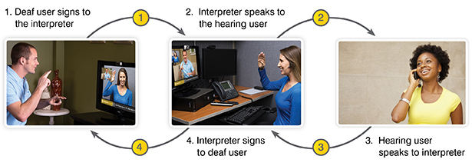
Video Relay Service
Notes:
FCC
Telecommunications Relay Service
Free
Meant to be used as a telephone service

Slide 65
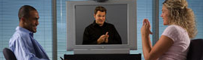
Video Remote Interpreting One on One
Interpreter is anywhere, signing to deaf woman, listening and speaking to hearing/speaking man
Man hears doesn’t sign
Woman is deaf and signs
Need:
Computer and video cam
Microphone/speakers or telephone
Good internet connection

Slide 66
Scenario + Discussion
The library is holding a workshop. A woman who is hard of hearing requests an assisted listening device in accordance with the stated timeline on the registration form - “Please request accommodations at least 14 days in advance.”
Is the organization allowed to state timelines?
Can she be charged for the cost of the assistive listening device?

Slide 67
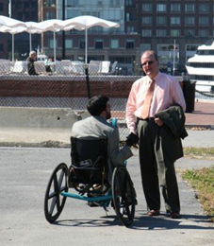
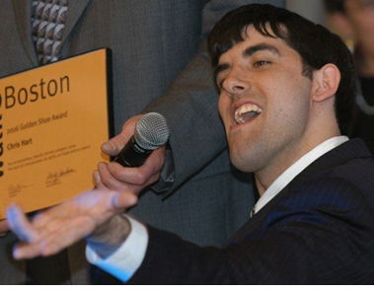
People Who Have Speech Disabilities
Notes:
rev. 1/96

Slide 68
When providing an auxiliary aid or service, the organization is required to provide what the person wants no matter how much it costs. True or False?

Slide 69
Undue Burden
Provide unless it would be an undue financial and administrative burden
Undue burden means “significant difficulty or expense”
Title II: Decision must be made by head of public entity or his/her designee in writing
Notes:
1.4

Slide 70
End of Ensuring Effective Communication
General Nondiscrimination and Reasonable Modifications Next

Slide 71
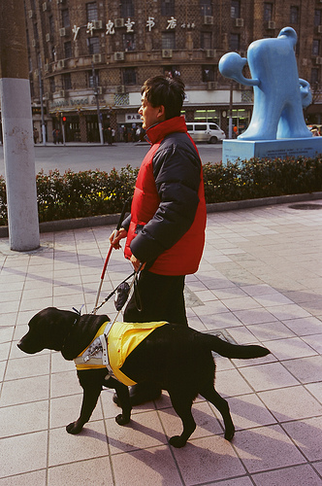
General Nondiscrimination
A man who is blind and uses a service animal goes to a library alone.
The security guard won’t let him in because the guard is concerned that the man will walk into the displays.
Has the library violated the ADA?

Slide 72
General Nondiscrimination Requirements
Do not:
Prohibit
Exclude
Segregate
Provide unequal treatment
Ensure that people with disabilities have an equal opportunity to participate in the most integrated setting appropriate.

Slide 73
General Nondiscrimination
When necessary to ensure a person with a disability equal opportunity to participate, “reasonable modifications” must be made to policies, practices, procedures

Slide 74
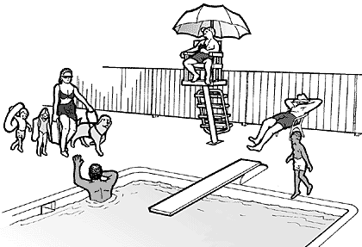
Service Animals

Slide 75
ADA Service Animal Definition
Any dog individually trained to do work or provide tasks for the benefit of an individual with a disability, including a physical, sensory, psychiatric, intellectual, or other mental disability
Notes:
1.1
If they meet this definition, they are considered service animals under the ADA regardless of whether they have been licensed or certified by a state or local government.
Service animals are not pets. They perform some of the functions and tasks that the individual with a disability cannot perform for him or herself.

Slide 76
Deaf
Hard of Hearing
Blind
Low Vision

Slide 77
People who Have Epilepsy

Slide 78
Other examples of work or tasks
Providing physical assistance
Providing non-violent protection or rescue work
Alerting individuals to the presence of allergens

Slide 79
Service Animals People with Psychiatric Disabilities
Preventing or interrupting impulsive or destructive behaviors.
Sensing that an anxiety attack is about to happen and taking action to avoid the attack or lessen its impact.

Slide 80
Not considered work or tasks
The crime deterrent effects of animal's presence
The provision of
emotional support
well-being
comfort
companionship
Notes:
1.1

Slide 81
An Organization May Ask
Is the dog a service animal required because of a disability?
What work or task has the animal been trained to provide?
Notes:
1.1
A vest is not required; nor is certification of training under the ADA. State law might have additional requirements for accessibility.
May be trained by service animal agency, private individual/trainer, or the owner/handler themselves
May or may not wear special collars or harnesses
May or may not be licensed/certified and have documentation therefore this can not be required as proof that it is a service animal for admittance

Slide 82
Scenario + Discussion
Ms. R is attending a function at your facility.
She has a service dog because of a disability.
The service dog starts to growl when someone passes by.
Do you have to allow this?
Notes:
The ADA does not cover housing, but it does cover a towns policies and procedures

Slide 83
Service Animals
Must be under control of owner at all times (on leash except in narrow circumstances)
Notes:
Care/supervision is owner’s responsibility
May exclude if animal's behavior poses a direct threat to health or safety

Slide 84
Reasonable Modification of Policies, Practices and Procedures Miniature Horses
Notes:
1.1

Slide 85
Scenario + Discussion
A library has a “No food or Drink” policy
Mr. G takes medication because of his disability and needs to drink a few times an hour.
What is the library’s obligation in this circumstance?
Notes:
Mr. G takes medication because of his disability and needs to drink a few times an hour. The medication causes his mouth feel dry and cottony (a common side effect of some medications).
The museum has a policy of no food or beverages.
What is the museum’s obligation in this circumstance?

Slide 86
Scenario + Discussion
Mr. F sends an email to you stating that he will be attending an event that your organization is holding in two weeks.
He has multiple chemical sensitivity and must be in a building that has used only unscented cleaning products in the past week and where no one is wearing perfume, cologne and other scents.
What is your organization’s obligation?

Slide 87
Customer Requests
Lessons for staff:
Initial response: Never say “no”
Say “yes” OR let person know you’ll get back to them
Know whom to discuss the request with
Be flexible
Determine if request is an ADA obligation or if it’s a customer service issue
Be timely in your communication

Slide 88
Web Accessibility
Follow WCAG 2.0 guidelines
www.w3.org/WAI/intro/wcag
Notes:
What does access mean:
Be able to use website without a mouse
Provide a text description for a pictures
Use a text-based format, such as HTML or RTF
Design websites so the users can set color and font in web browsers and operating systems
Use titles, context, and other heading structures to help users navigate complex pages or elements
Minimize blinking, flashing, or other distracting features

Slide 89
End of General Nondiscrimination and Reasonable Modifications
Facility Access Next

Slide 90
Facilities Built Before the ADA
How much accessibility is required in these older buildings?
Notes:
2.1

Slide 91
Minimum Accessibility for Older Buildings
Accessible route to an accessible entrance from each site arrival point
Accessible parking (if parking provided)
At least one accessible entrance
Accessible route inside the building to goods and services
Accessible toilet room(s) (if provided)

Slide 92
Accessible Route from Site Arrival Points
Notes:
Streets and sidewalks
Transportation stops
Parking
Passenger loading zones
(where provided)

Slide 93
Accessible Route
Stable
Firm
Slip resistant
36” min width

Slide 94
Accessible Entrance Historic Building, Stairs & Ramp

Slide 95
If not all entrances are accessible…
Signs at inaccessible entrances

Slide 96
Service Counters
Counter section lowered for people who use wheelchairs and people who are short
Notes:
36” high max
Accessible part same depth
Parallel or forward approach

Slide 97
Service Counter
Temporary Solution:
Have a clipboard available

Slide 98
Facility Access
A library service: Computers for public use.
Problem for people who use wheelchairs

Slide 99
Accessible Workstations
-Surface height: 28-34 in.
- Adequate knee clearance
- Clear floor space: 30 by 48 in

Slide 100
Toilet Rooms
Allows space for side transfers

Slide 109
Signs
Signs at permanent rooms & spaces
Must be visual, raised and tactile

Slide 110
Directional or Informational Signs
Required:
Contrast
Non-glare
Character size depends on viewing distance
Not required:
Braille
Raised characters

Slide 111
Protruding Object
Adaptive Environments

Slide 112
Maintenance of Accessible Features

Slide 115
Issues that Make an Accessible Space Inaccessible
Cars/delivery trucks blocking an accessible space or curb ramp
Protruding objects/items blocking the accessible route
Plants/trash cans in front of elevator buttons
Trash cans at the paper towel dispenser or door in the restroom

Slide 116
Issues that Make an Accessible Space Inaccessible
Slippery or wet floors
Snow not shoveled from accessible parking spaces and all accessible routes (front on sidewalk, back at parking lot)
Elevators and lifts that don’t work

Slide 117
www.ADAChecklist.org

Slide 118
Contact Me With Any Questions
Thank You!!
Stacy Hart, New England ADA Center
Shart@NewEnglandADA.org
1-800-949-4232

