Slide 1
CREATIVE ADULT PROGRAMMING
PENNY CUNNINGHAM
KATARZYNA JANIGA
BURNHAM MEMORIAL LIBRARY

Slide 2
PROGRAMMING OUTSIDE THE BOX
FEATURED PROGRAMS
FIBER FEST
COOKING THE BOOKS
LITERARY BUS TRIPS
Stabbing with the pointy end was never so much fun!
Why read it when you can also eat it?
Or how to take 50 patrons across the border and bring them in back in one piece.

Slide 3
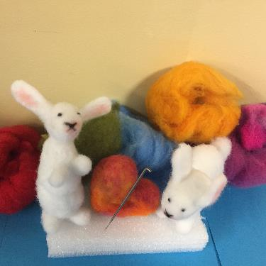
FIBER FEST

Slide 4
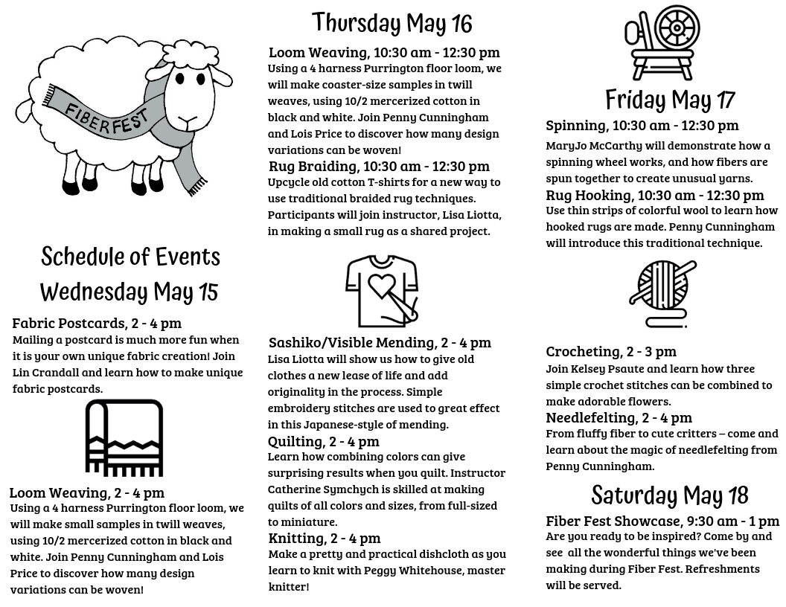

Slide 5
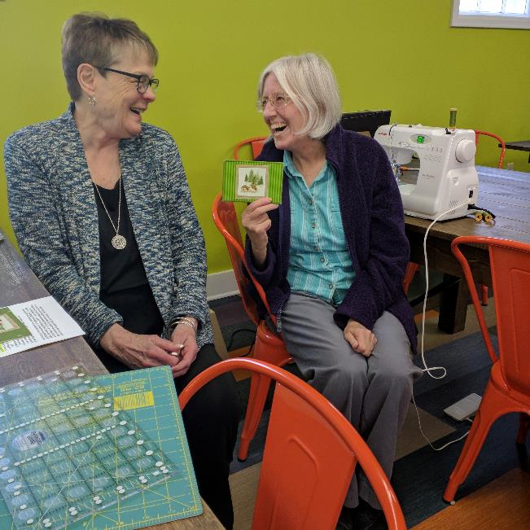
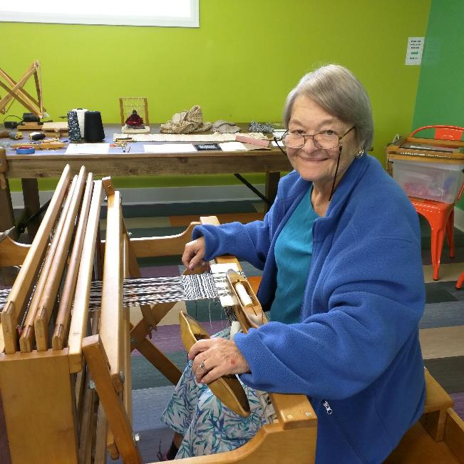
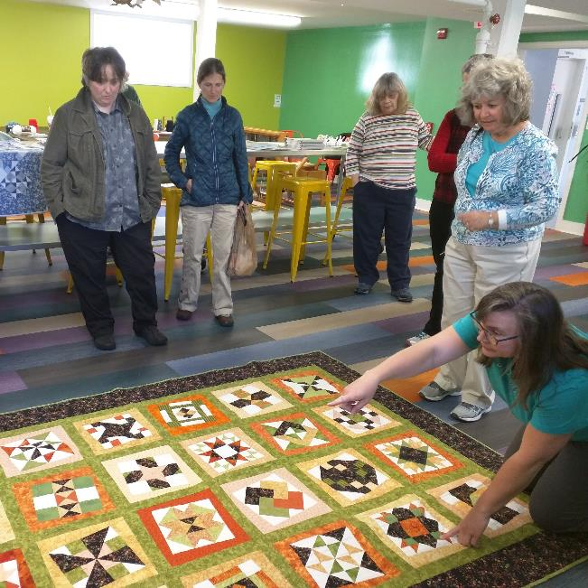

Slide 6
FIBER FEST
RESOURCES
Green Mountain Rug Hooking Guild
www.gmrhg.org
Vermont Weavers Guild
www.vtweaversguild.org
Northeast Fiber Arts Center
www.northeastfiberarts.com
Selvedge Magazine
www.selvedge.org

Slide 7
COOKING THE BOOKS

Slide 8
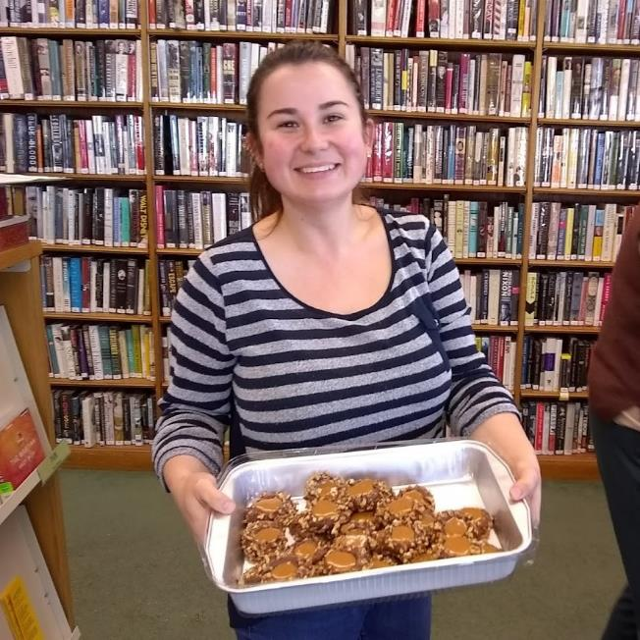
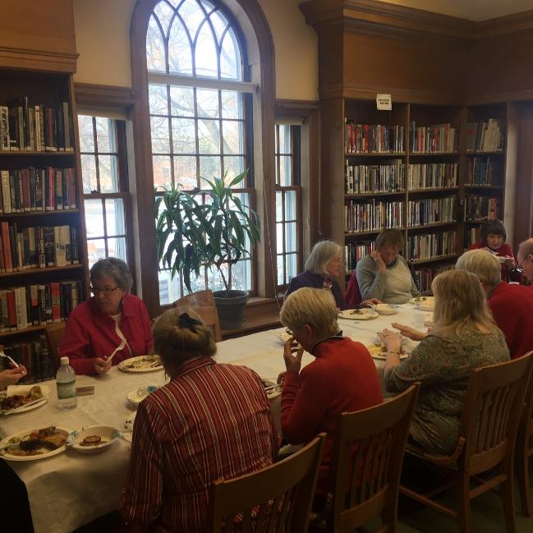
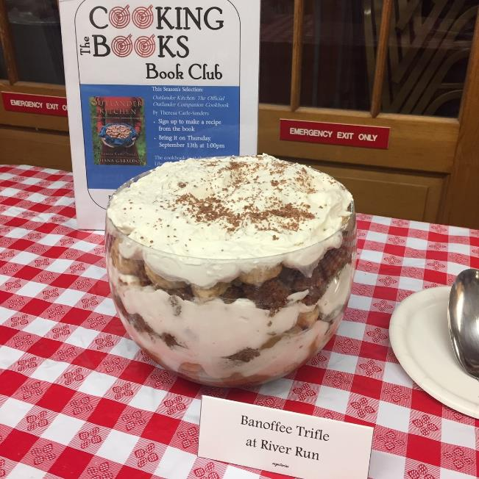

Slide 9
LITERARY BUS TRIPS:
Our Annual Louise Penny Trip to the Eastern Townships

Slide 10
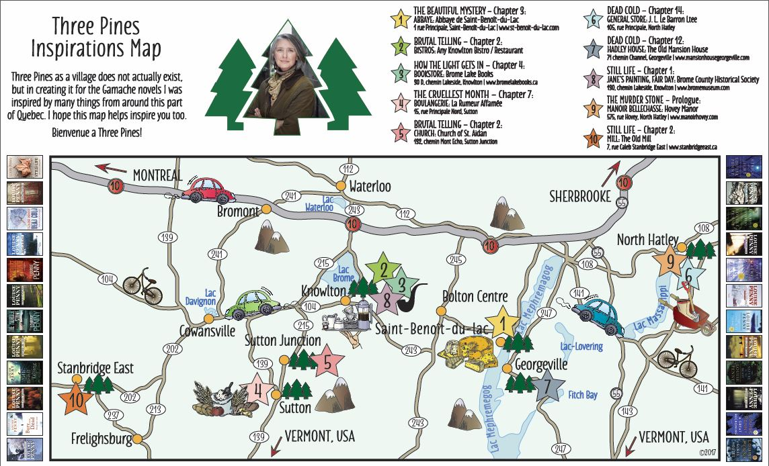

Slide 11
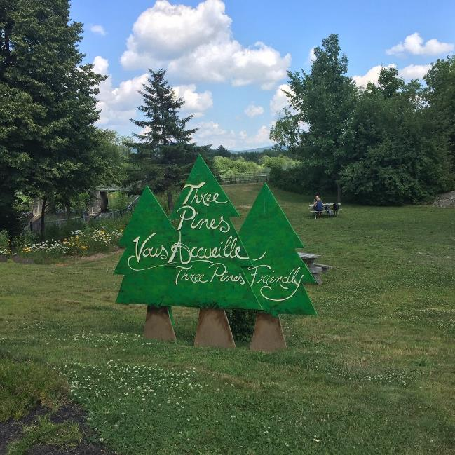
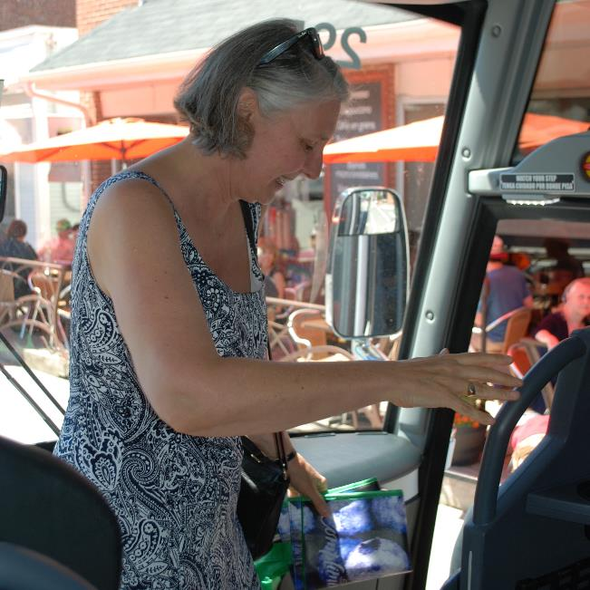
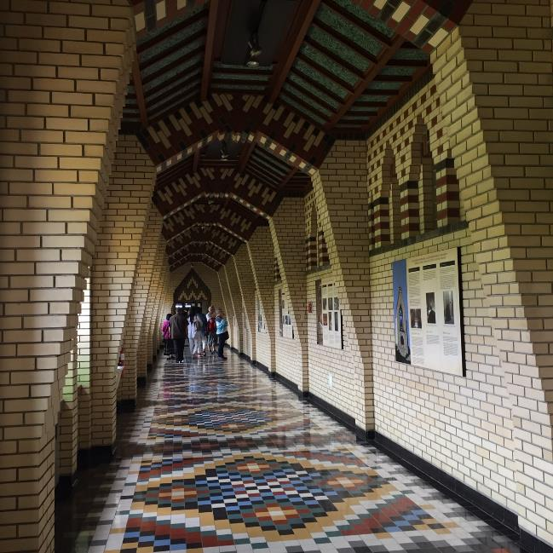

Slide 12
LOUISE PENNY BUS TRIP
RESOURCES
Louise Penny’s Official Site
https://www.louisepenny.com/
Three Pines Inspiration Map
https://www.easterntownships.org/tourist-routes/12/three-pines-inspirations-map-louise-penny
Abbaye St-Benoit-du-Lac
https://www.easterntownships.org/things-to-do/113/abbaye-de-saint-benoit-du-lac
Tourisme Quebec
https://www.quebecoriginal.com/en-us/where-to-go/regions-cities/eastern-townships

Slide 13
CONTACT INFORMATION
Penny Cunningham
pcunningham@colchestervt.gov
Katarzyna Janiga
kjaniga@colchestervt.gov

