Slide 1


A Vermont Romance Turns 100!
Paul Carnahan, Vermont Historical Society
Fred Pond, UVM
Orly Yadin, Vermont International Film Foundation

Slide 2

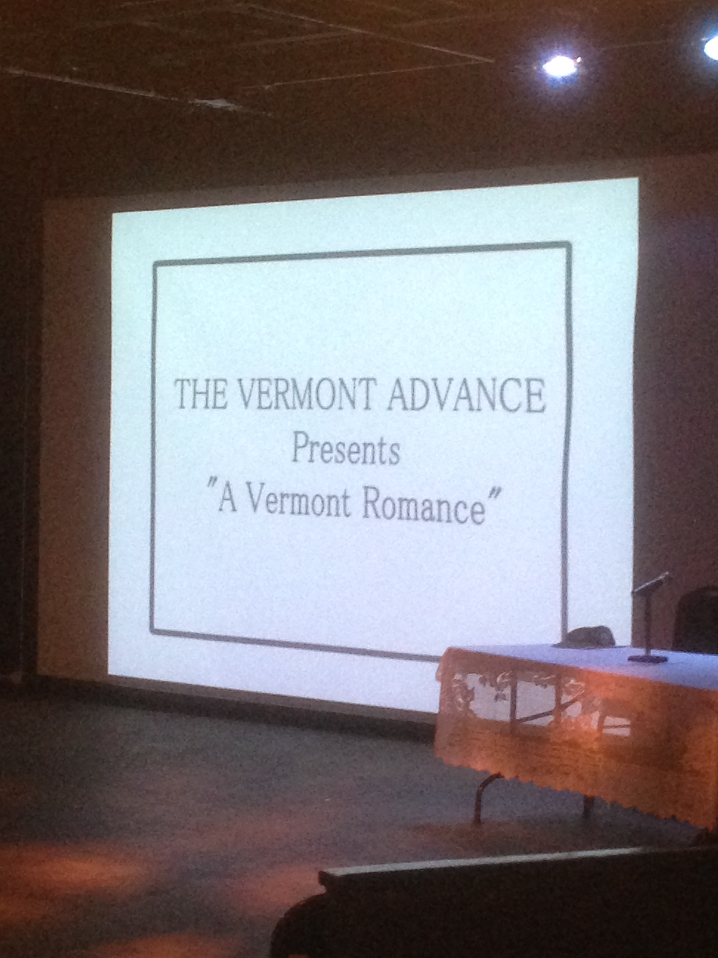
Introduction

Slide 3
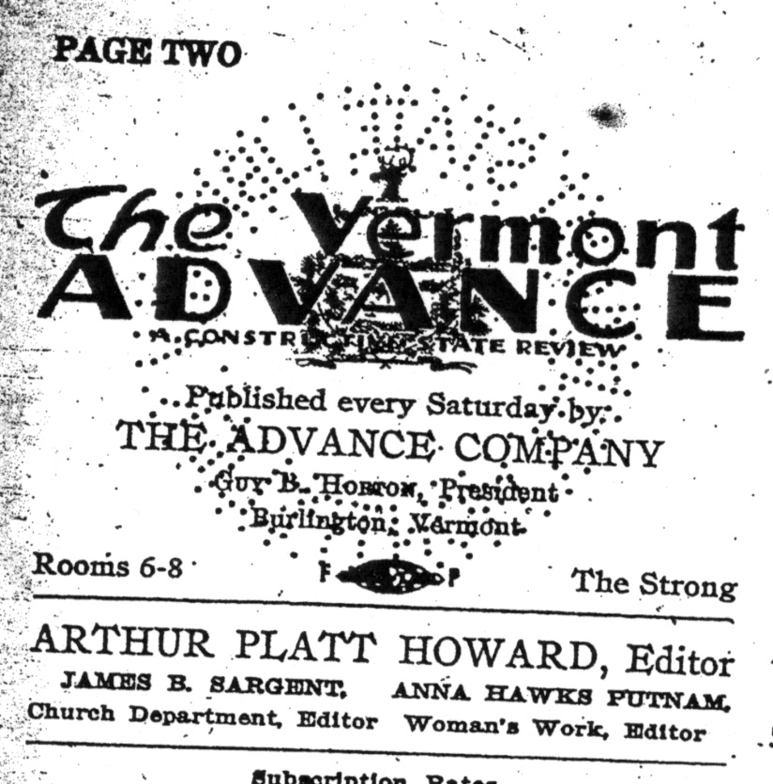
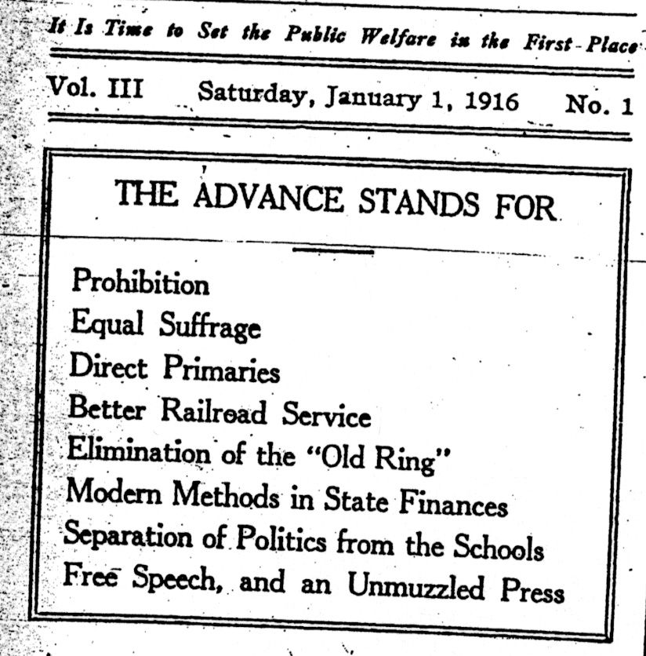
History

Slide 4
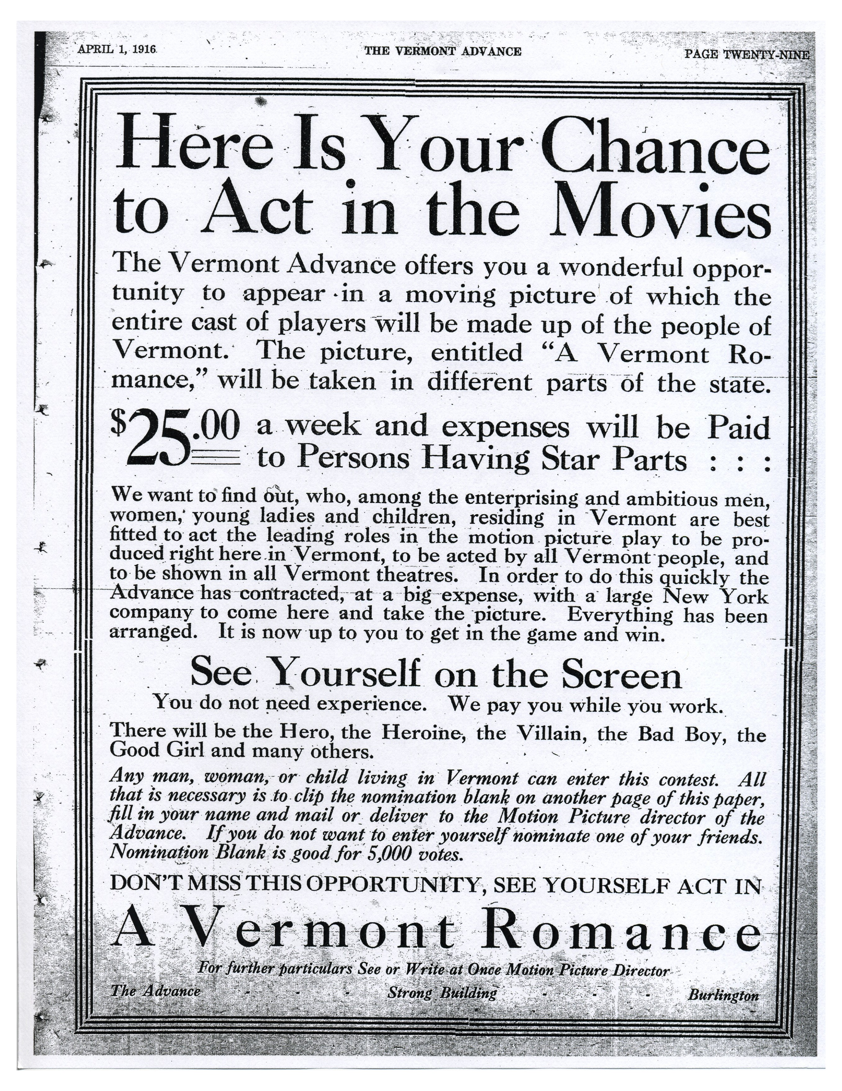

Slide 5
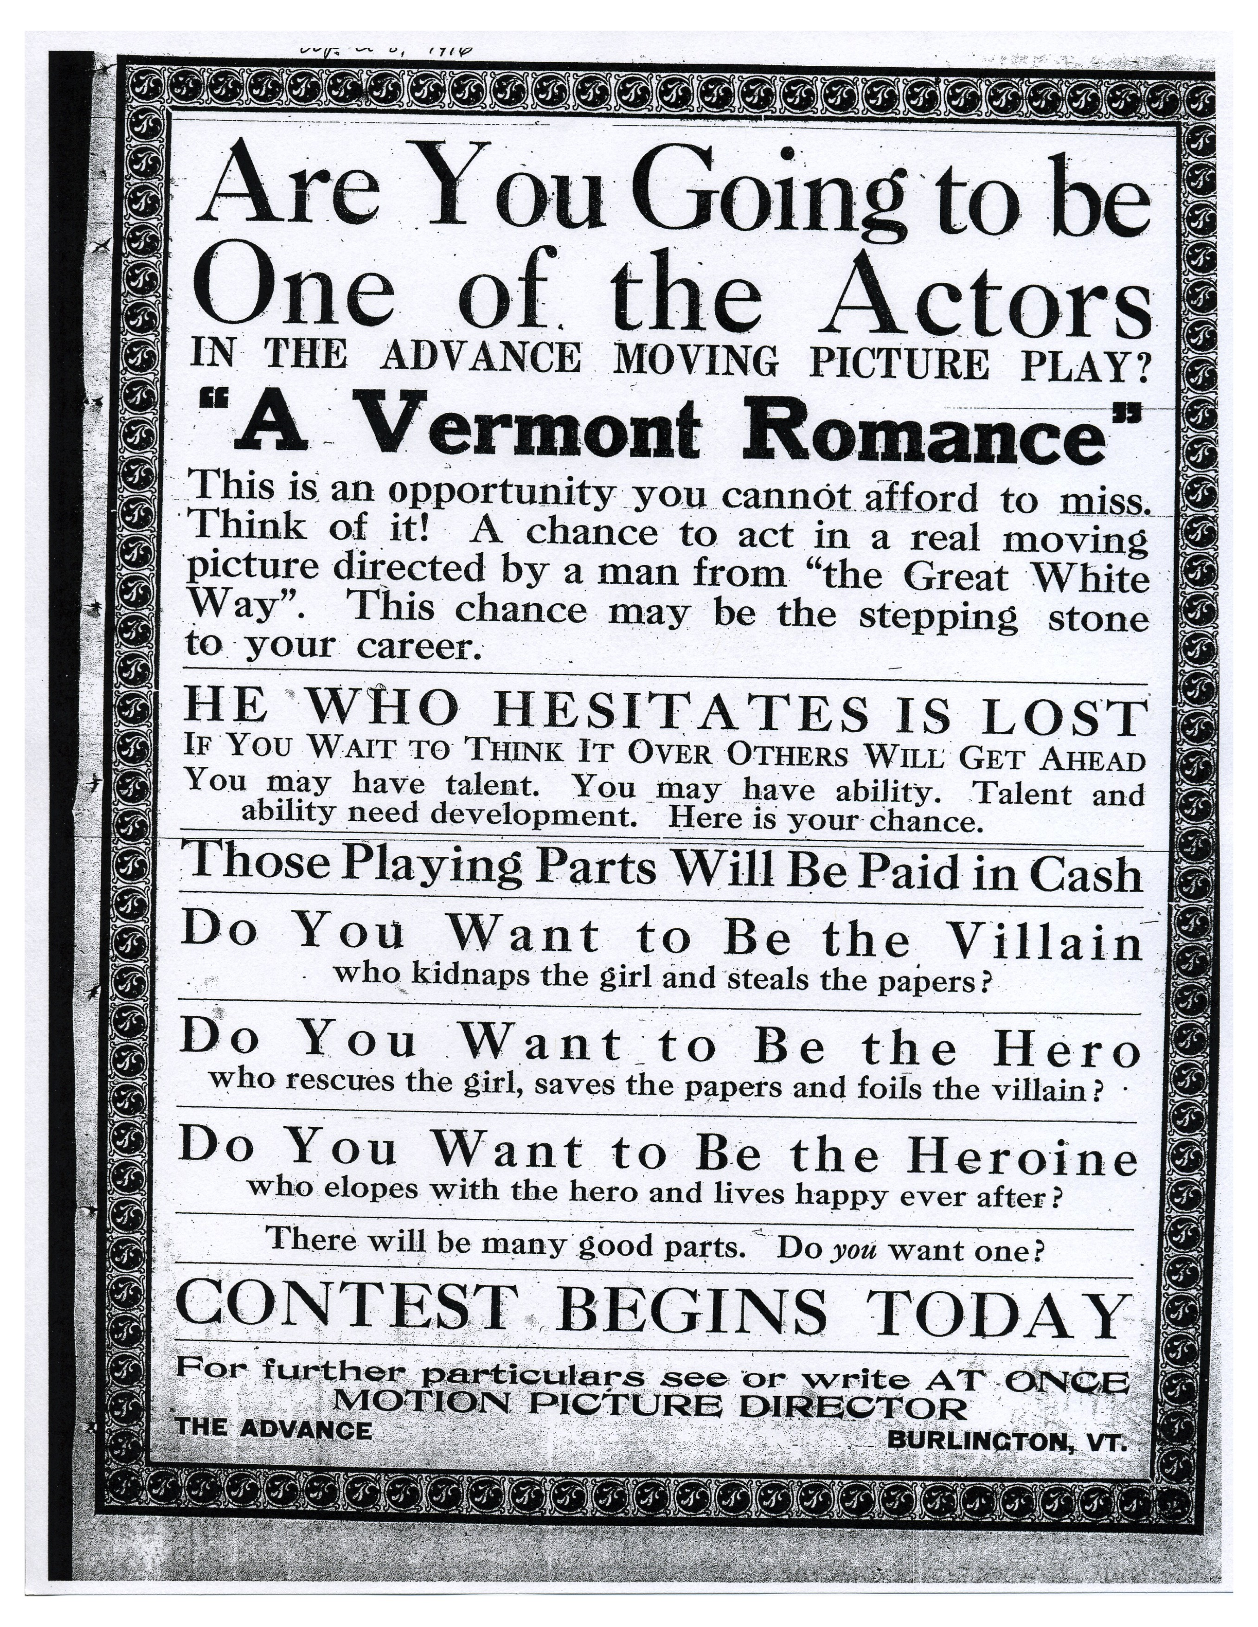

Slide 6
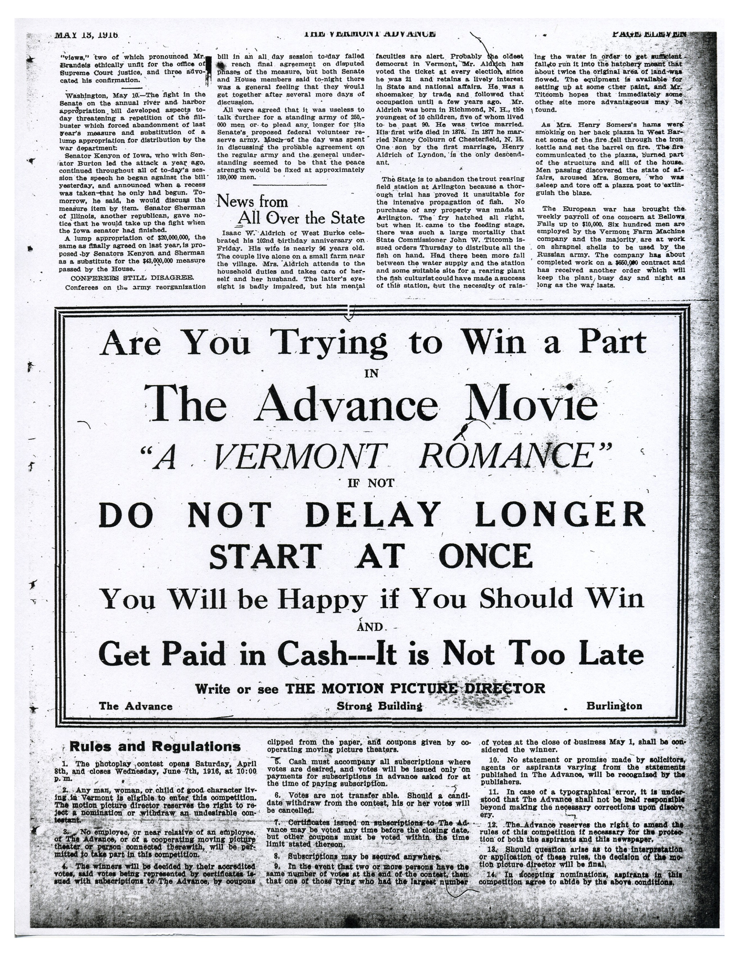

Slide 7
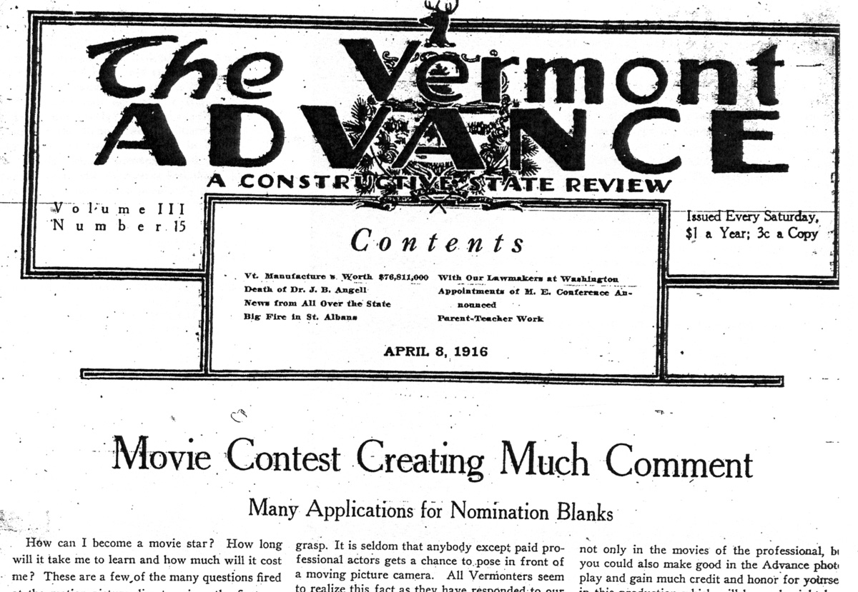

Slide 8
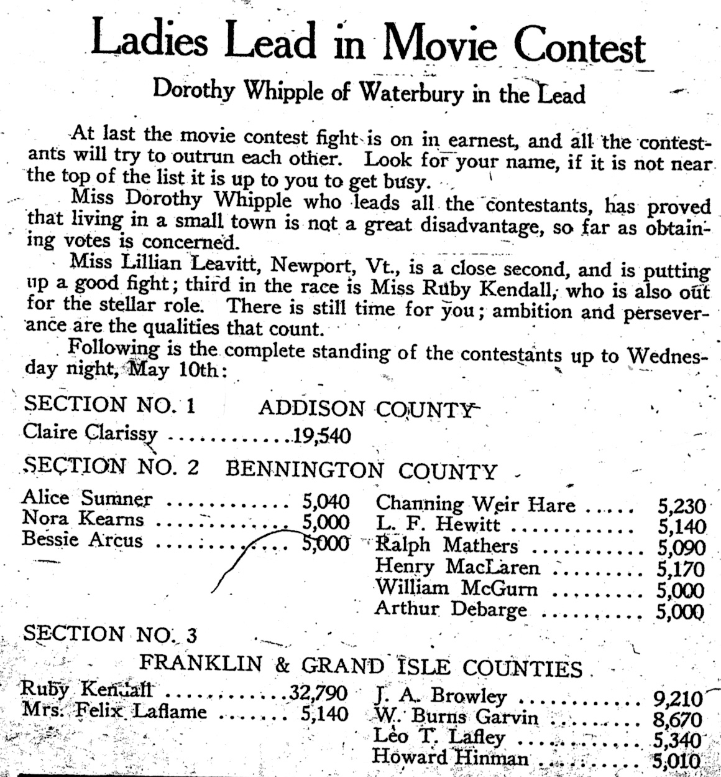

Slide 9
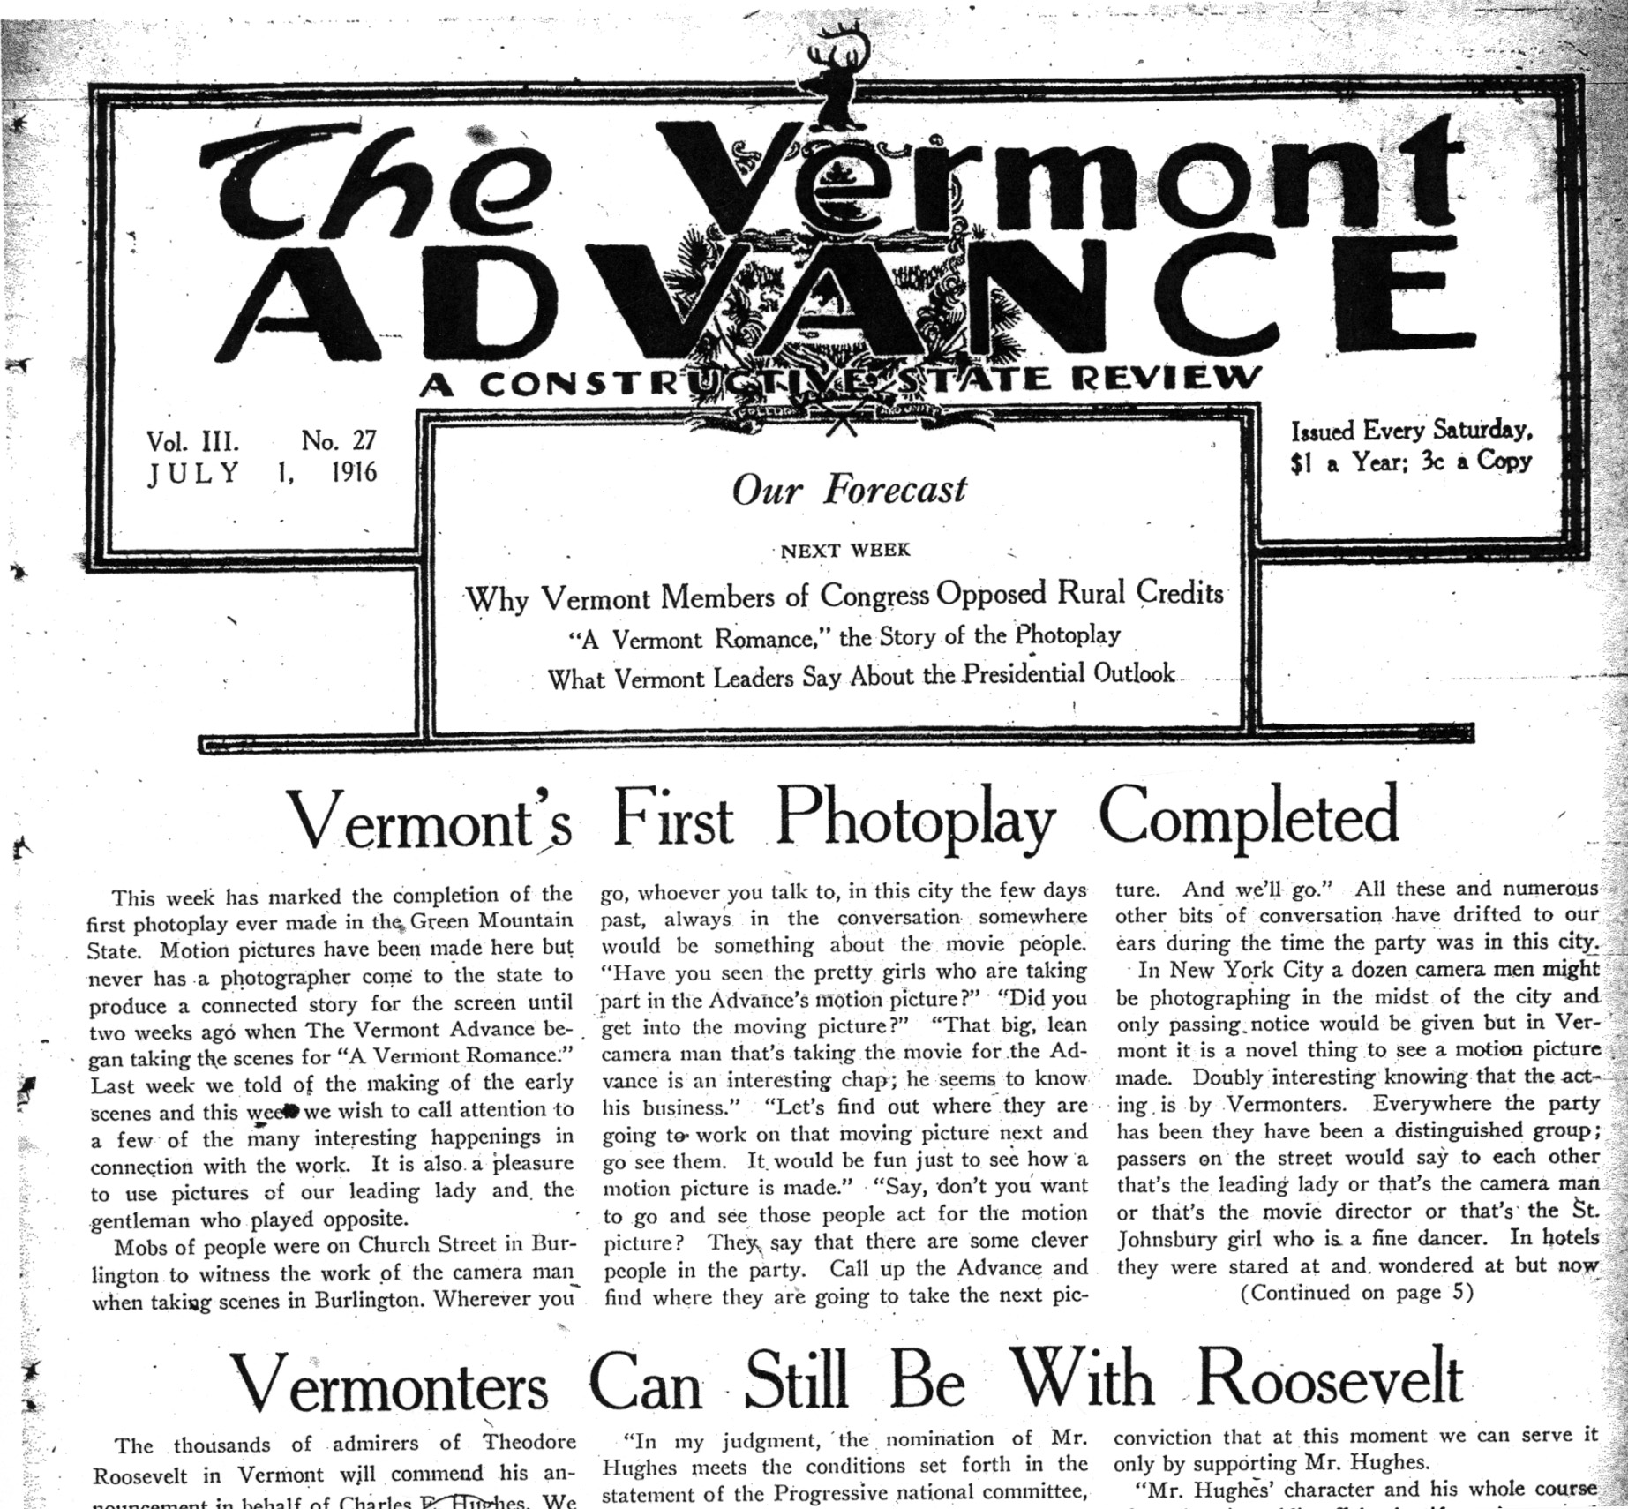

Slide 10
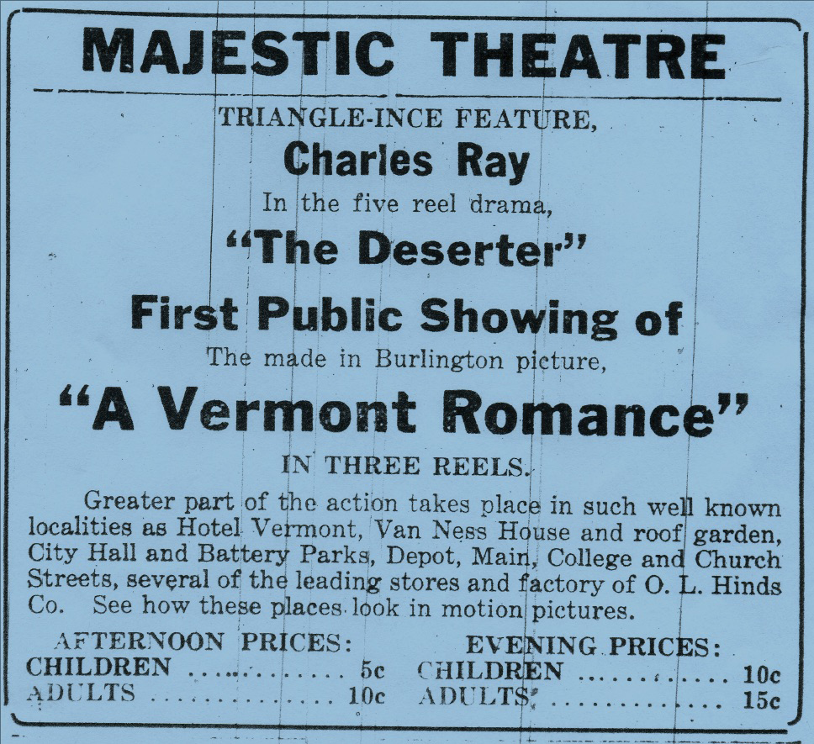

Slide 11
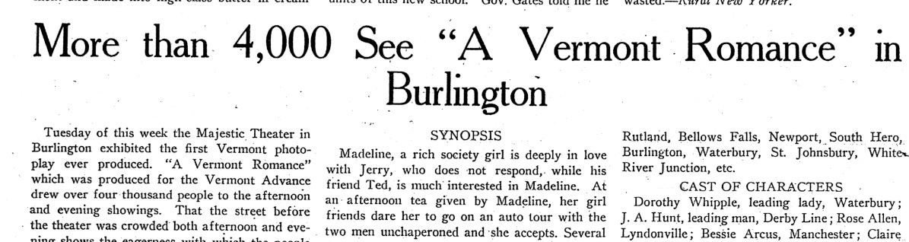

Slide 12
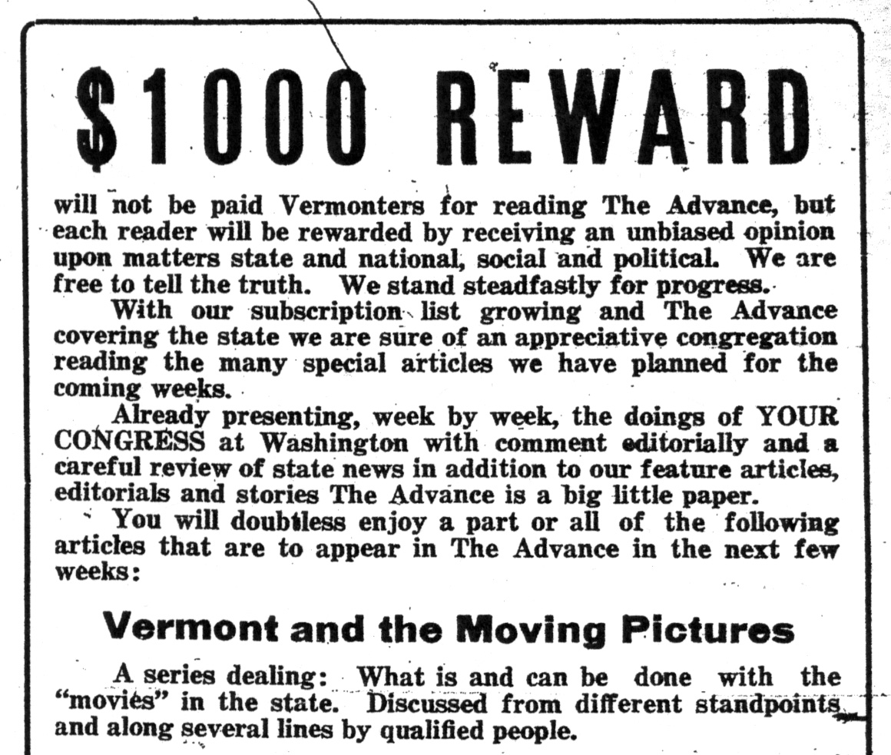
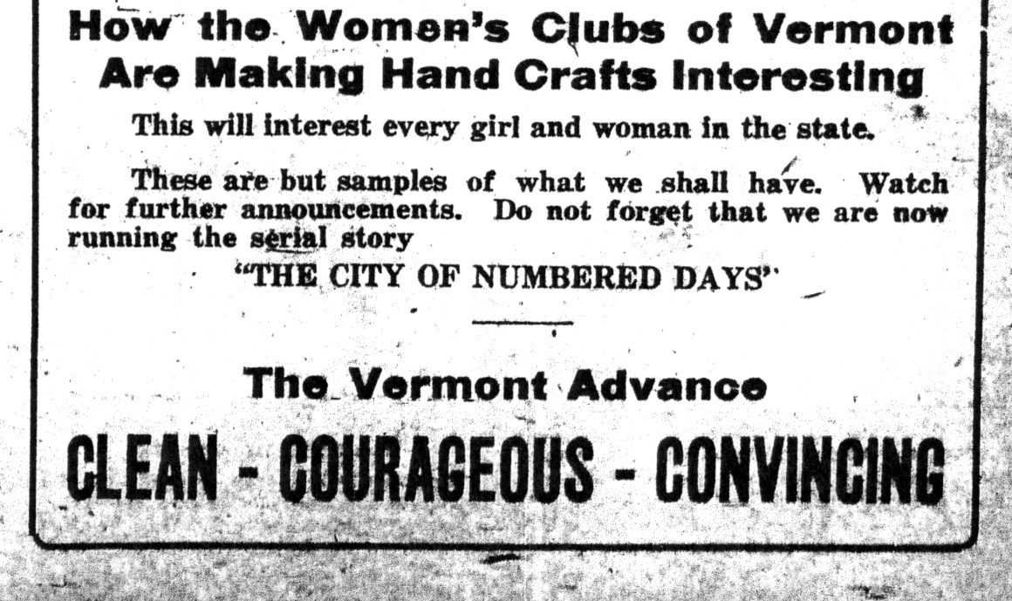

Slide 13
Selected Scenes
A Vermont Romance
1916

Slide 14

Vermont Movie Archive Project

Slide 15
Quick Survey
Format: DVD or Blu-ray?
Supplemental Material: PDFs, Director’s Cuts, additional material?
A voice-over commentary option?
Bibliography?
Recommendations for additional viewing?
What else would enhance a historical DVD?

Slide 16
Summary
Contact VAMP & VHS when old films are discovered.
Videos have historic value also, and may not be as stable as film.
Help us find related materials that include A Vermont Romance.

Slide 20
A Vermont Romance
Upcoming Screenings
Orleans County: Haskell Opera House, Derby Line. Sunday, May 22, 4pm.
Orange County: Chandler Music Hall in Randolph, Friday, June 3, 7pm.
FMI or to arrange a screening, contact: Orly Yadin, Vermont International Film Foundation, info@vtiff.org

